Slide 1
Understanding Employee Engagement through Social Analytics
IOT, AI: Technology for Sustainability and the Planet; Opportunities and Challenges to Wider Deployment
Edan Dionne
IBM Corporation
5 November 2019
UN SPB Forum, Canberra, Australia

Slide 2
Content
UN SPB Forum, Canberra, Australia
Data, IoT, AI ...
Examples of current applications
Challenges involving wider deployment
Q&A / group discussion

Slide 3
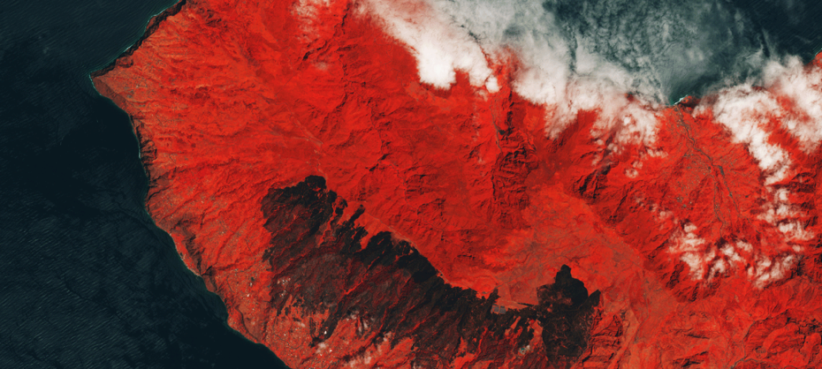
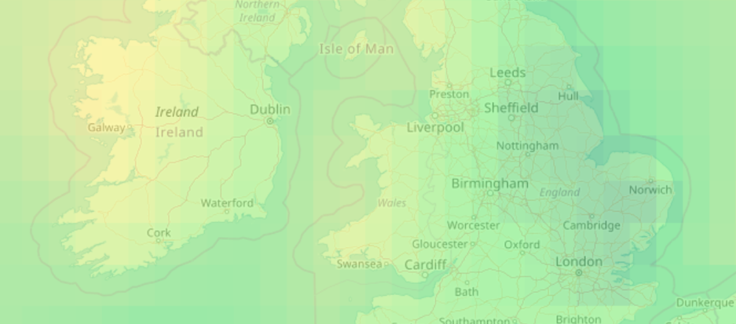
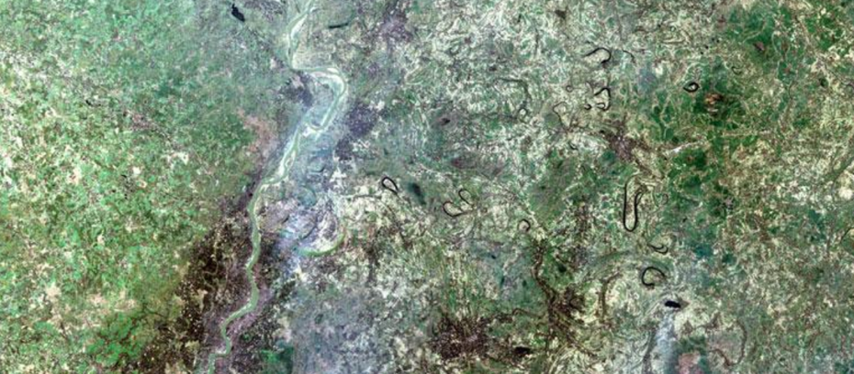
Geo Data
Sensors
Cloud
MODIS data
Sentinel data
Internet of Things
Weather data
Other data
Landsat data

Slide 4
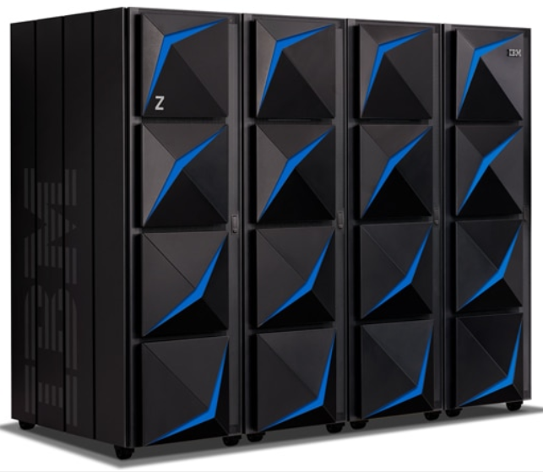
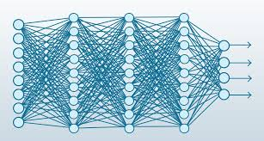
ARTIFICIAL INTELLIGENCE
Making of intelligent machines and programs
MACHINE LEARNING
Ability to learn without being explicitly programmed
DEEP LEARNING
Learning based on Deep Neural Networks
AFFORDABLE COMPUTE AT SCALE
IoT

Slide 5
UN SPB Forum, Canberra, Australia
The Jefferson Project at Lake George (2014 - )
One of the United States’ pristine lakes
Spring and tributary-fed with only one outlet at northern end
Partners:
IBM
Rensselaer Polytechnic Institute
The FUND for Lake George
Goals include:
Understanding the threats such as pollution and invasive species impacting the lake and potential mitigation strategies.
Developing a template to use in other fresh-water bodies around the globe.

Slide 6
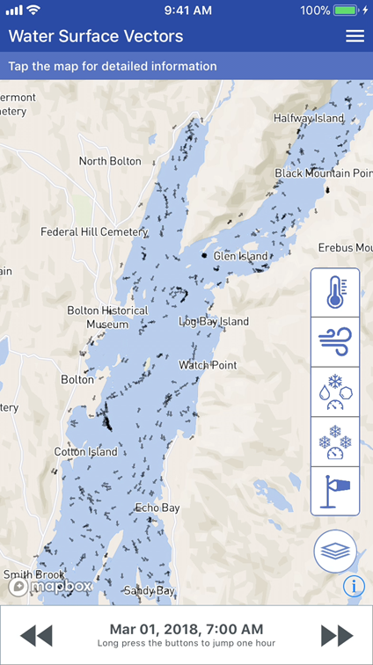
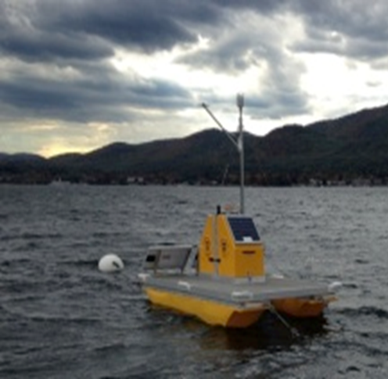
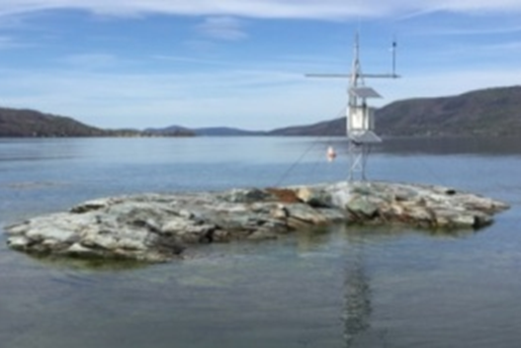
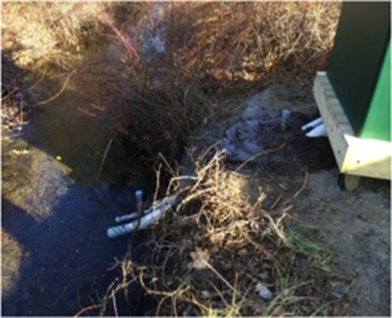
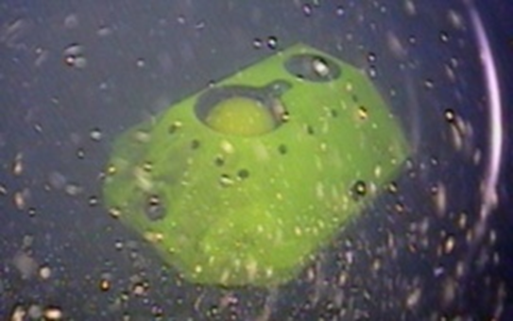
Environmental Insights System – real time, event driven, distributed intelligence
Operational Model
Forecasting Platform
IoT / Analytics Platform
Visualization
Chemistry / Biology
Scenario Engine
Circulation / Ice / Particle
Analytics
Runoff / Pollutants
Data &
Semantics
Weather / Land Surface
IoT Edge Nodes (sensors with real time, autonomous edge analytics and AI)
The Weather Company
Mobile App: sensor data
and model forecasts
Acoustic Doppler Current Profiler
Vertical Profiler
Weather Station
Stream Station

Slide 7
UN SPB Forum, Canberra, Australia
The Jefferson Project: metrics at-a-glance
What | 2013/2014 | Now | Importance
Sensor network | 2 temporary water quality sensors; 1 weather station. | 51 platforms (weather, flow, depth, current, etc.) | Density, location, operation at high frequency. Integration with analytics platform for real time decision making, distributed decision making, real-time QA/QC of the data.
Weather stations | 1 permanent, 1 at local airport. | 12 - 15 | Resilient to environmental elements. Data quality.
Physical parameters monitored | None continuously. | A multitude of well-placed (model-driven) sensor suites. | High density, high frequency measurements. Fully automated cyberinfrastructure.
Chemical & biological parameters monitored | Full suite – manual, limited. | Full suite – fully automated.

Slide 8
UN SPB Forum, Canberra, Australia
The Jefferson Project: metrics at-a-glance (continued)
What | 2013/2014 | Now | Importance
Analytic / IoT | None | State of the art edge analytics. | Ability to drive sensors at high speed under local control with real-time analytics, including AI predictions of measurement for comparison to next measured values.
Physical modeling(circ., (runoff, weather) | None | State of the art physics-based models. | Data set quality and density. Evolution of model physics. Advances in computation.
Computational capabilities | None | Distributed edge processing at each sensor station. HPC cluster for model computation. | Assets packaged for individual deployment in cloud environments.
Visualization capabilities | None | Automated generation of plots and animations daily. IoT data available via web GIS interface. IoT and model forecasts can be overlaid in a 3D gaming engine. | Automation of visualization execution. Evolution of gaming engine technology.

Slide 9
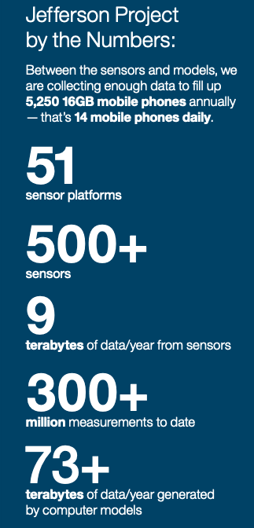
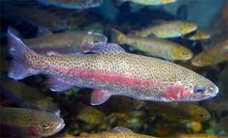
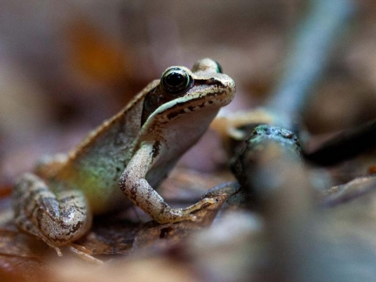
UN SPB Forum, Canberra, Australia
Highlights of Findings
Road salt pollution - in high salt environments, rainbow trout are stunted while developing tadpoles change sex from female to male.
Invasive species - data helped with understanding of distribution and abundance.
Excess nutrients - Smart Sensor Network highlighted need to monitor both surface and bottom algae.
Next
Acquiring / using additional data or modeling to enhance understanding and improve predictive analytic capabilities toward developing measures / controls to reduce impact

Slide 10
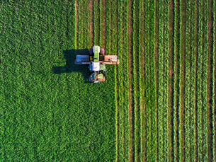
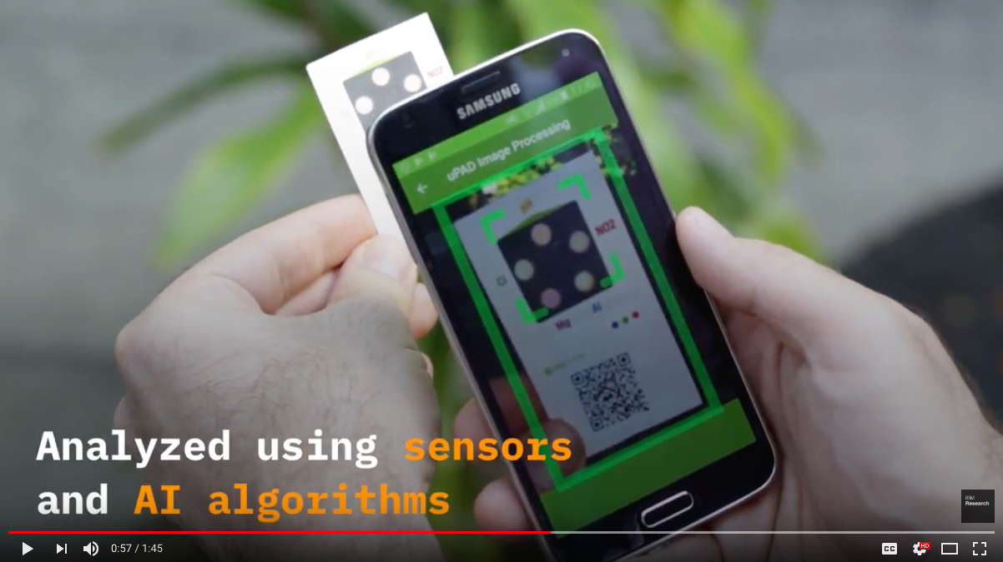
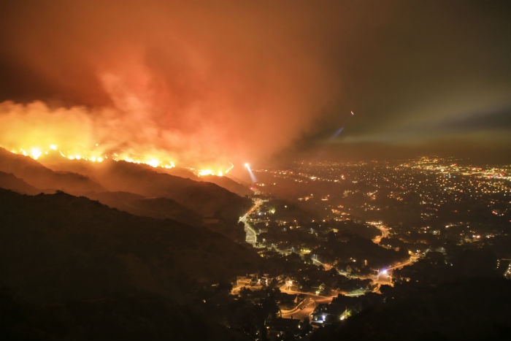
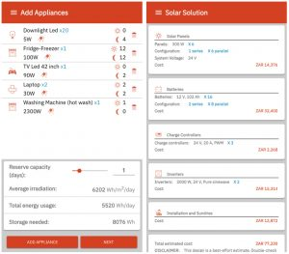
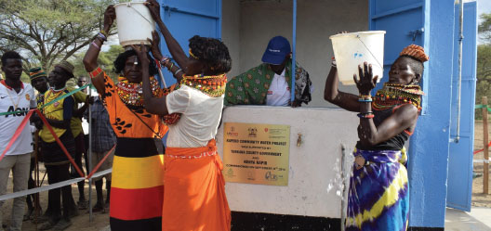
UN SPB Forum, Canberra, Australia
AgroPad
Wildfire detection
Watson™ Decision Platform for Agriculture
Microscopes in the ocean to monitor plankton
Empower Solar app
Kapedo Community Water Project, Kenya

Slide 11
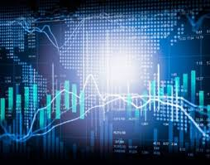
UN SPB Forum, Canberra, Australia
What about Sustainability and planet Earth?

Slide 12
UN SPB Forum, Canberra, Australia
Deploy,
Scale,
Sustain
The technologies are available now.
If policy makers compel their use the positive impacts will be significant.
Innovative financing mechanisms can scale deployment.
New partnership models across public, private and not-for-profit organizations will enhance outcome.
Public awareness, education and involvement will contribute toward advancing our goals.

Slide 13
Tech for Good

