Slide 1
Findings of the sixth Global Environment Outlook
Elaine Baker
GRID-Arendal at the University of Sydney
Notes:
700 plus page report
146 authors
Experts from over 70 countries

Slide 2
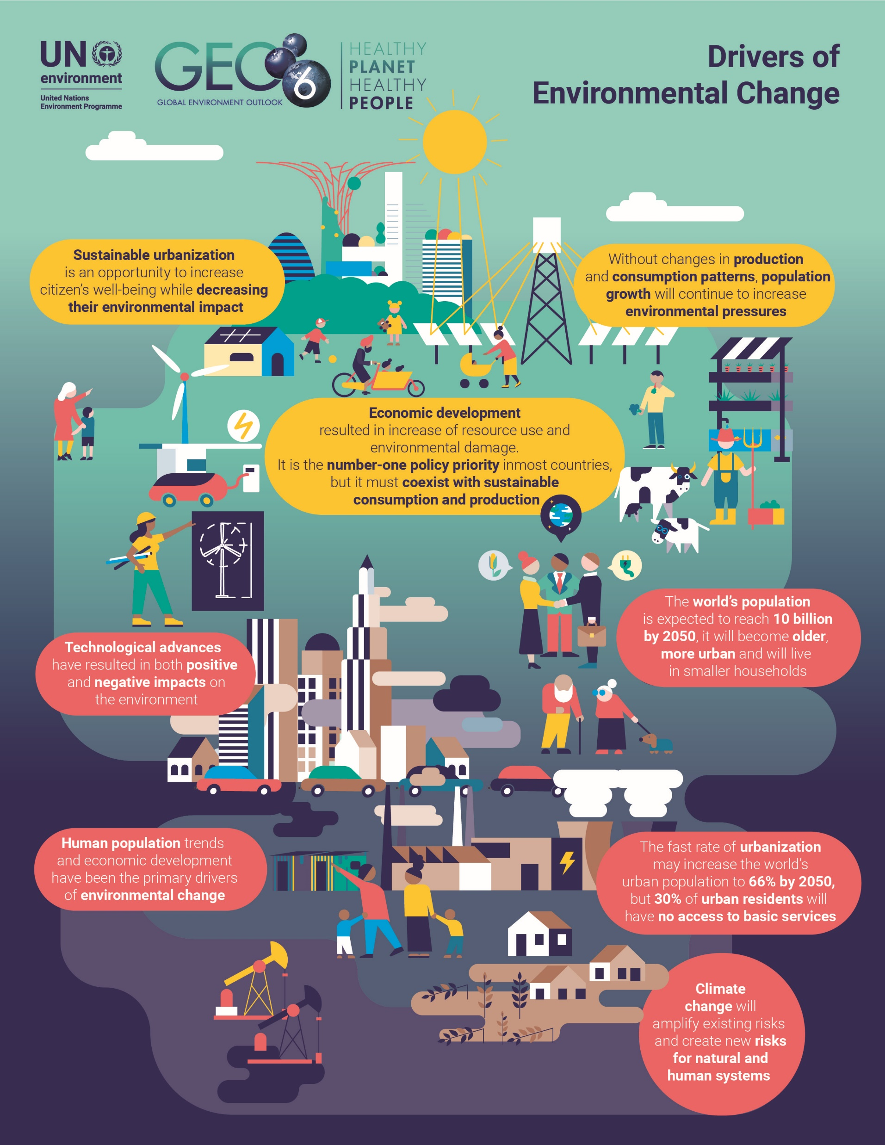
6 Drivers of environmental change
Population
Economic development
Demographics
Urbanization
Technological change
Climate change
6 Cross cutting issues
Human health
Environmental disasters
Energy
Chemicals
Waste and wastewater
Education for sustainable development
Notes:
Population - 9-10 billion by 2050
Economic development –eradicate poverty,, but increases consumption and extraction of resources
Demographics - older in richer countries, younger in poorer countries
Urbanization - 6-7 billion living in cities by 2050, 2-3 billion informal settlements
Technological change – can improve agricultural productivity for example, but creates more waste
Climate change – already a 1 degree Celsius increase. We will have sea-level rise, more severe weather events – droughts and floods
Human health – 9 million premature deaths due to environmental pollution in 2015. Mainly indoor and outdoor air pollution, but also water pollution and sanitation.
Environmental disasters – Affected more than 3 billion people between 2005 and 2015
Energy –1.2 billion people don’t have access to electricity and 2.7 billion still use traditional fuels for cooking and heating.
Chemicals – More than 100,000 chemicals in use with chemical pollution now a global threat.
Waste and wastewater – urban waste generation is about 7-10 billion tons/yr.
Education for Sustainable Development – is essential for changing lifestyles and habits.

Slide 3
Air 6-7 million premature deaths now from air pollution, projected only a small decrease in 2050. Policies to reduce GHG emissions can produce health benefits by reducing air pollution. Financial savings from these health benefits could be double the cost of climate policies
Land Food production is the primary use of land. We will need 50 percent more food to feed the 10 billion people on the planet in 2050. Currently use more than 50% of arable land, waste 30 % of food
Fresh Water– 1.4 million people die from pathogen-polluted drinking water and 2.3 billion do not have access to safe sanitation. Antibiotic and antimicrobial resistance are projected to be a major cause of death in 2050. 40 % of wetlands gone. Freshwater species populations declined by 81 per cent between 1970 and 2012
Ocean and coasts – coral bleaching events are now occurring at 6-year intervals, while recovery normally takes 10 years. Fisheries and aquaculture supports up to 120 million livelihoods. 20 % of the protein for over 3 billion people. 8 million t. of plastic enter the ocean each year.
Biodiversity We might be observing the sixth mass extinction in the earth’s history. Declines in species, ecosystems and genetic diversity.
Notes:
Air pollution main contributor to global burden of disease, estimated to cost 5 trillion annually. Need to cut emissions by 40-70 % to limit us to 2 degrees of warming by 2050
Water – most regions water quality decreased since 1990 – chemical, plastics heavy metals etc- emerging problems endocrine disrupters, nanoparticles, antibiotics; but increases in the number of people with access to water and sanitation.

Slide 4
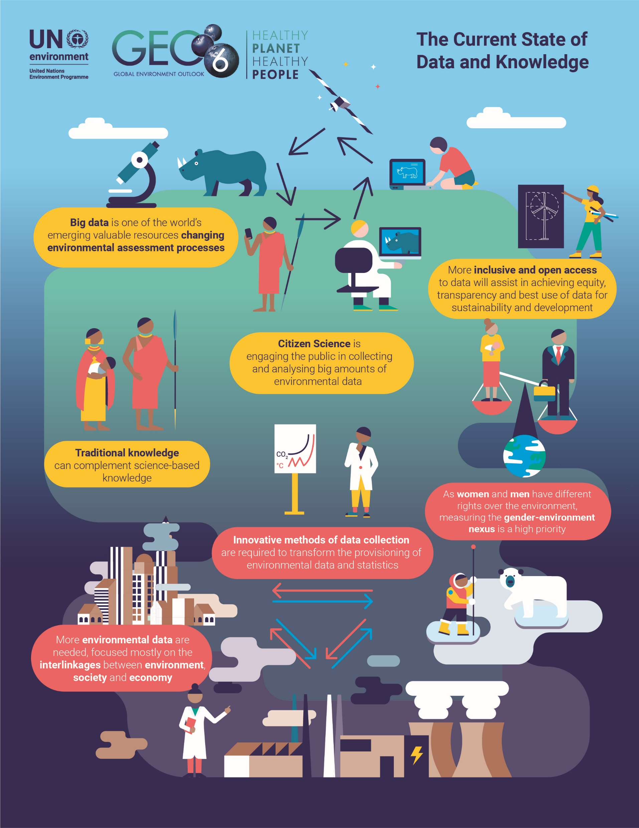
State of our Data and Knowledge
Data and knowledge has improved since GEO-5 – more environmental statistics, complemented by better monitoring and geospatial data.
Still data gaps –much of the data required to monitor the SDGs are unavailable.
New emerging data and knowledge systems – big data and analytics (earth human system models), citizen science, traditional knowledge.
Notes:
Data a huge resource for environmental assessment and monitoring
Capacities are limited by resources and funding, especially in developing countries. Much real-time big data are held by the private sector though many data products are made freely available for public good .
We need time series data to monitor change. Public-private projects provide opportunities
to strengthen information systems and develop innovative data-collection methods

Slide 5
Changing the path we are on
Improvements in human development, but policies insufficient to meet environmental dimension of SDGs and IAEGs – continued human health risks
Further degradation in nearly all environmental areas– from climate change to biodiversity loss to water scarcity, land degradation and ocean acidification.
Failure to act now will lead to ongoing and potentially irreversible impacts on the environment and human health.
Pathways exist to meet the environmental dimension of SDGs – changes in consumption, production, and environmental management.
Business needs to help drive change in food and energy systems, support the development of a circular economy by developing markets, processes and enabling policies
Incremental policies will not be sufficient – all pathways require rapid and wide-ranging social and technological innovations; many beyond historic rates of change

