Slide 1
Spurring Transformation through Resource Efficiency and Circularity SPBF - Canberra November 2019
Ian McAlister
Chief Executive Officer
CESA

Slide 2
The Home Appliance Industry on 6 continents
Ian McAlister
IRHMA member
&
CEO Consumer Electronics Suppliers Association

Slide 3
IRHMA - The International Roundtable of Household Appliance Manufacturer Associations
Latest innovations
Knowledge-sharing Different realities

Slide 4
Nine Associations on Six Continents
AHAM
APPLiA
AEB
CHEAA
KEA
JEMA
the United States
Europe
Russia
China
Korea
Japan
ANFAD
SADA
CESA
Mexico
South Africa
Australia

Slide 5
Advancing citizens’ lifestyles: Dishwashers vs. Washing by hand
10 times less water
2/3 less energy

Slide 6
Successfully preventing food waste

Slide 8
New technologies require worldwide cooperation
Harmonised Rules

Slide 9
How to ensure Cybersecurity?
Coherent, smarter
legislation
Policy makers
worldwide
can
further ensure safety.
Less prescriptive
solutions
Harmonised
standardisation

Slide 10
Free trade should always be the guiding light
Avoiding tariffs
Staying away from trade barriers
Preserving domestic jobs

Slide 11
Product Policies contributing to
Circular Economy
Policy Tools contributing to sustainability:
- protect the environment and human health;
- make products more energy and resource efficient;
- empower consumers to choose better products; and
- reuse, repair and extended producer responsibility.

Slide 12
Steps to the Circular Economy
Circular design and production processes;
Investment in innovation;
Efficient waste management system; and
Stakeholder engagement

Slide 13
Action plans for the Circular Economy
EU Action Plan
Australian Plans/Policy
- National Waste Policy
- Circular Economy Hub
- National Packaging Waste Targets
- Recycling Investment Fund
- Energy and Water Efficiency Regulation
- Product Stewardship Legislation

Slide 14
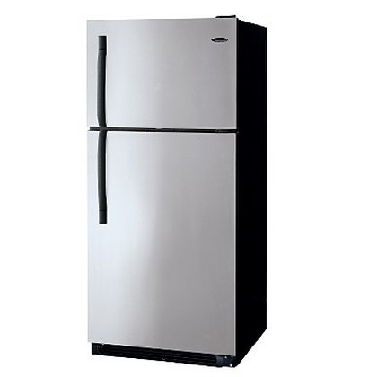
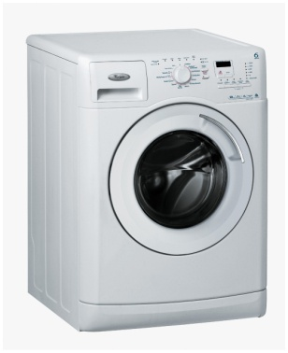
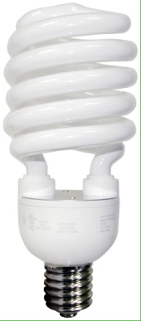
Energy Efficiency Regulation Regulated Products (MEPS and labelling)
Regulated products
Refrigerators
Clothes washers and Dryers
Dishwashers
Freezers
Electric motors
Air conditioners
Televisions and Set top boxes
Distribution transformers
Electric motors
Electric water heaters
External power supplies
Lighting equipment
Computers and Monitors

Slide 15
Australia’s Context
Australia has a small manufacturing
base;
Australia is an earlier adopter of
technologies and a good test bed; and
Must take into account our trading
environment

Slide 16
Industry Contribution
The Home Appliance Industry makes a significant contribution to the environment and resource efficiency globally through innovative energy and water efficiency design and global standards.
The message I wish to leave you with today is the importance of a greater role for industry in the development of UN Environment Policy and Guidelines, particularly in regard to product stewardship guidelines and the benefits of innovative product design to facilitate recycling and extended life through the ability to repair.

Slide 17
THANK YOU
www.cesa.asn.au

