Slide 1



Leading the charge to 2050
Success factors for an energy efficient economy
eec.org.au
@EECouncil @lukemenzel

Slide 2













































































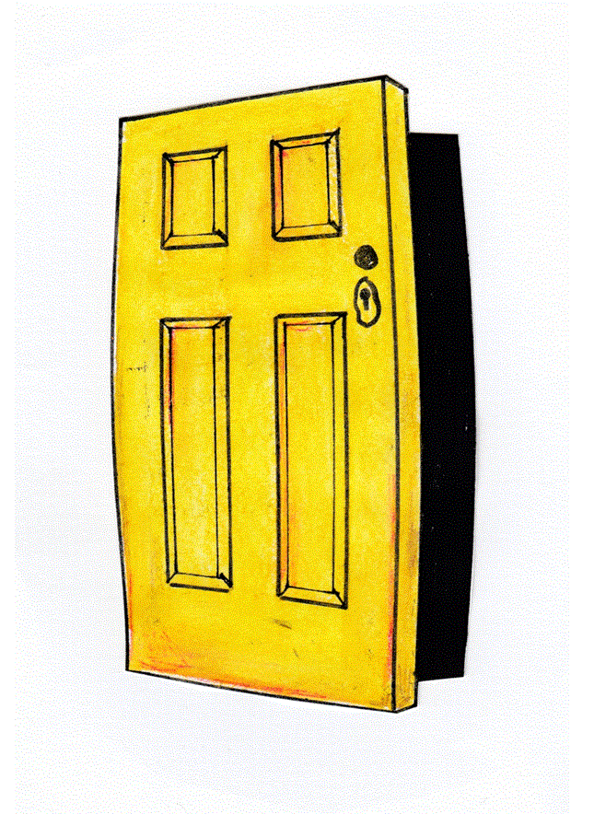







Slide 3
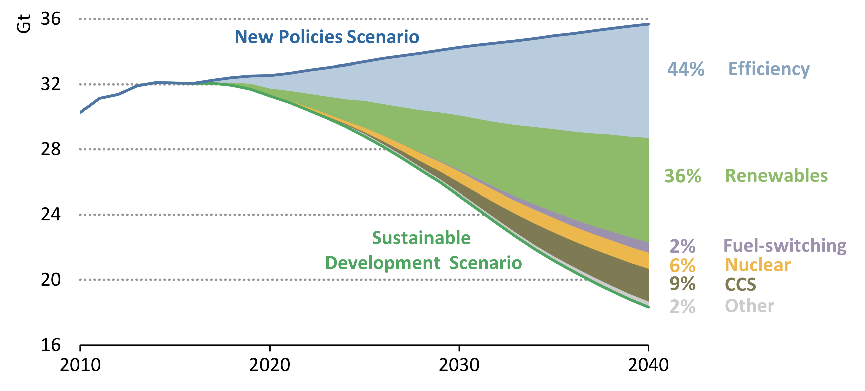
eec.org.au
International Energy Agency 2018, Energy Efficiency 2018: Analysis and outlooks to 2040, International Energy Agency, Paris.
@EECouncil @lukemenzel

Slide 4

“Policy is crucial”
Dr. Brian Motherway
Head of Energy Efficiency
International Energy Agency

Slide 5

eec.org.au
@EECouncil @lukemenzel

Slide 6
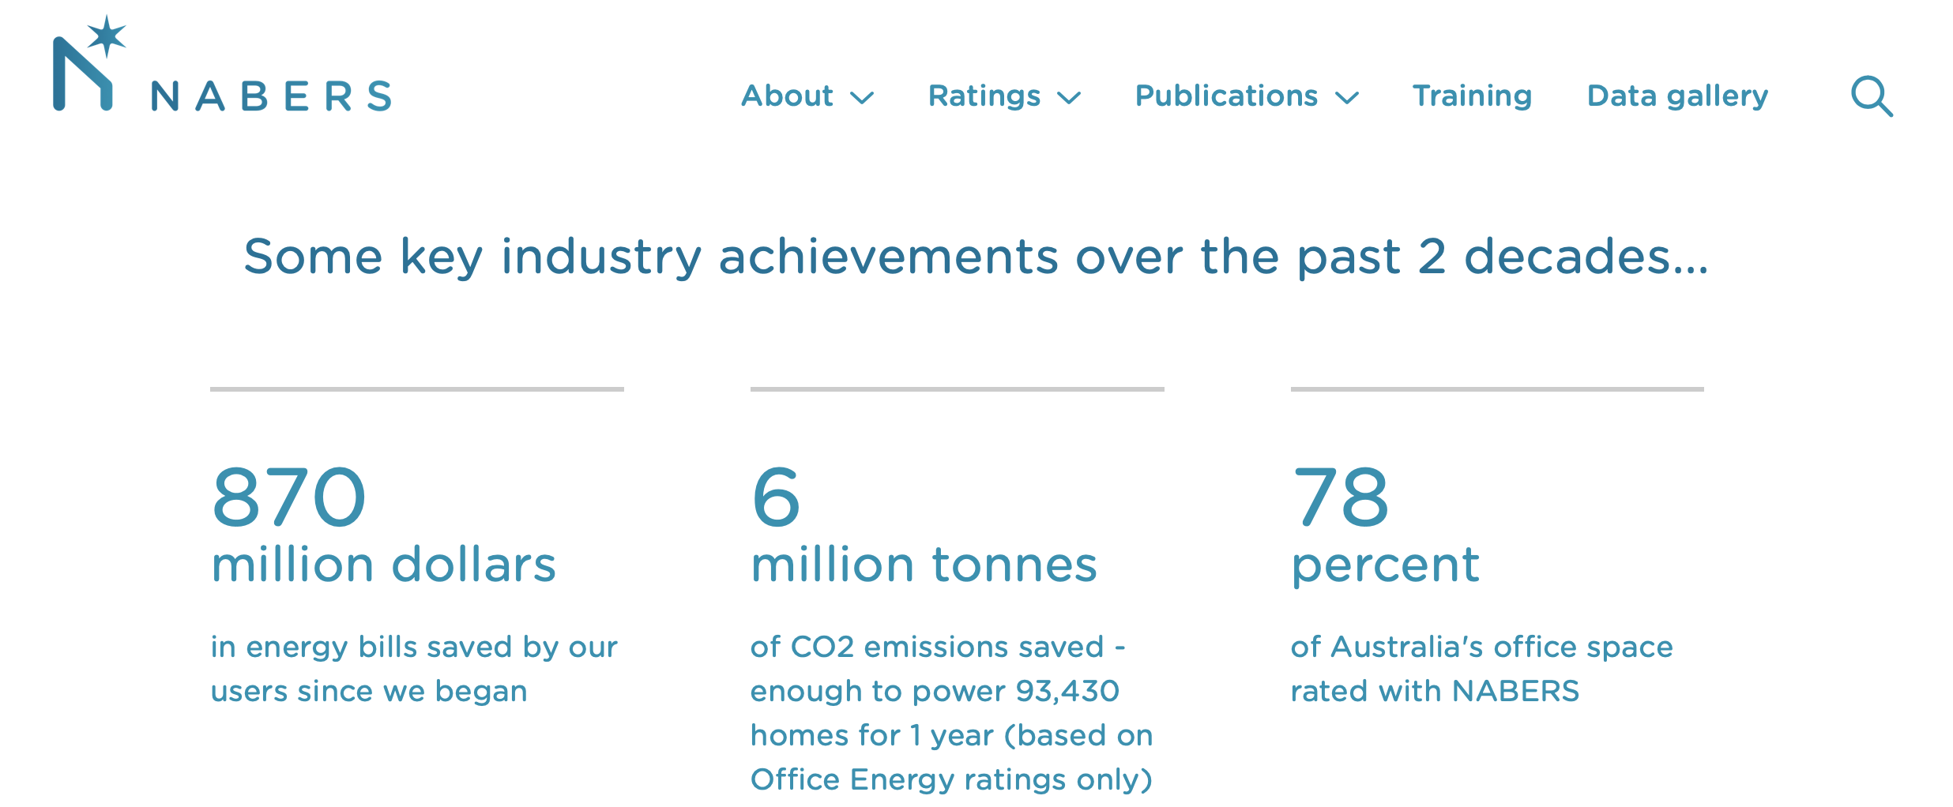
eec.org.au
@EECouncil @lukemenzel

Slide 7
Success factors for NABERS
Tailored to sector needs
Focused on user benefits
Backed by regulation
Industry at the table
eec.org.au
@EECouncil @lukemenzel

Slide 8
Hindrances for NABERS
Uncertain national policy
No sector targets
Limited complementary policy
No mandatory minimum standards
eec.org.au
@EECouncil @lukemenzel

Slide 9

Success factors for an energy efficient economy
Ambitious energy efficiency targets in line with net zero by 2050
Long term policy tailored to the needs of particular sectors
Quickly replicate successful programs across the economy – and around the world
eec.org.au
@EECouncil @lukemenzel

Slide 10

eec.org.au/handbook

