Slide 1
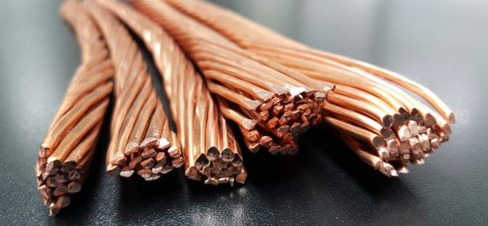
Resource Efficiency and Circularity by Steve Kukoda, Vice President/Executive Director
UNEP Science Policy Business Forum, Canberra November 2019
Notes:
There is no other material as important to climate change as copper.
As the world’s largest producer of copper, COP25 offers a unique opportunity for Chile to showcase its critical role in limiting the effects of manmade climate change.

Slide 2
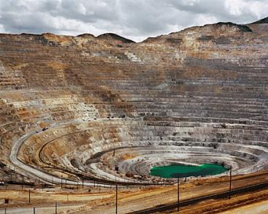
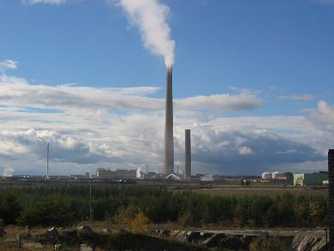
When you think of copper, what do you see?
Copper. Makes the World Work Better
Notes:
When the copper industry’s most critical stakeholders think about copper, what do they envision?
Click slide
An open pit mine that can be seen from outerspace?
Click slide
A stack at a smelter refiner, rising many meters into the sky and emitting vapor?

Slide 3









The copper mining story cannot be told with only one chapter
  Chapter One: Mining
  The End
Sustainable Development
Energy Efficiency
Climate Change Mitigation
Renewable Energy
Electrical Safety
Public
Health
Food
Supply
Green
Building
Air
Quality
Copper. Makes the World Work Better
Notes:
It is unfortunate that for many, the book on copper mining is a short one. To them, the book on copper reads like this:
CLICK
Chapter one: mining
CLICK
The End
Copper mining is just one chapter in a much larger book
Copper is mined because of its amazing properties
CLICK
If you were going to tell the whole story on copper mining, the largest chapter would need to be focused on stainable Development.
SD is on the minds of everyone and governments and industries are focused on decisions and practices that ensure a sustainable future for mankind.
SD is everywhere and with everyone and everything making claims related to SD, there is a danger that the overall SD message can become diluted.
Copper is uniquely able to contribute to solutions that make a sustainable future a reality.
When it comes to SD, copper has a unique story to tell: while other materials need to communicate about the sustainability of the material itself, with copper we can honestly communicate that copper makes the things that contain it more sustainable.
Climate Change Mitigation is one of the more important chapters in the book on copper as this presentation will show.

Slide 4
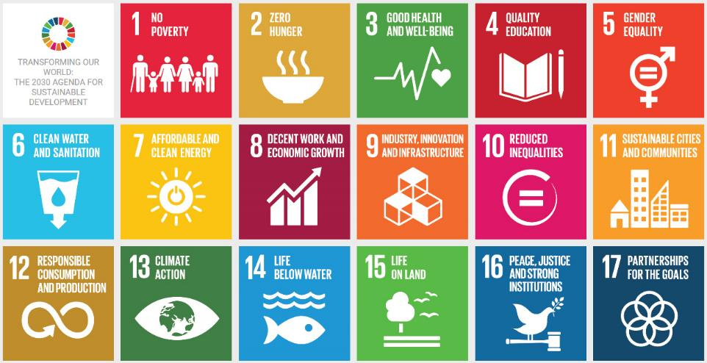
Copper: Critical to Sustainable Development
ICA’s programs are making an impact on all 17 SDGs
Notes:
As was stated in the previous slide, copper is critical to sustainable development.
Powerful evidence of this can be found when benchmarking copper against the 17 UN Sustainable Development Goals, or SDGs.
Through the investments of the copper industry in the International Copper Association, an audit shows that ICA’s programs are making some level of positive impact on ALL 17 SDGs.
The impact is greater on some more than others, especially SDG7 – Affordable and Clean Energy – and SDG13 – Climate Action.

Slide 5
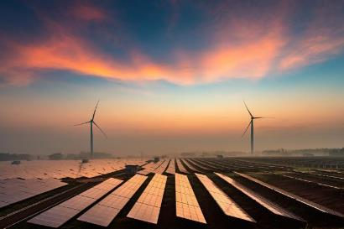

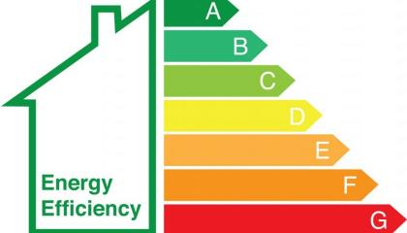
Three Pillars to Clean Energy Transition:
Renewables, E-Mobility, Energy Efficiency
Copper. Makes the World Work Better
Notes:
There are three pillars to the clean-energy transition:
Renewable Energy
Electro-mobility
And Energy Efficiency
Of these three Energy Efficiency gains the least amount of attention.
Indeed, when I was searching for images to visualize these three elements of the clean-energy transition, it was difficult to come up with a defining image on Energy Efficiency.
Let me explain why Energy Efficiency is so critical to climate change mitigation, and copper’s unique and important role.

Slide 6
Copper: Critical to Clean Energy
Copper is the best (non-precious) conductor of heat and electricity
The products that contain copper tend to operate more efficiently
  Over their life cycles, these products will consume less energy, save money and reduce CO₂ emissions
Renewable energy: 4-12X more copper
Electric vehicles: 3-4X more copper
Energy-efficient products use more copper
Copper. Makes the World Work Better
Notes:
Copper’s fundamental properties make it indispensable in the movement towards clean energy.
This is because copper is the best non-precious conductor of heat and electricity; only silver is a better conductor – and only marginally so – and for obvious reasons, a precious metal cannot be used in widespread conductive applications.
Because of copper’s superior conductivity, the end-use products that contain copper operate more efficiently than if an inferior conductor were to be used.
Over the life cycle of these products, less energy will be consumed and greenhouse gas emissions will be reduced; and, the users of these products will save money through reduced energy costs.
Indeed, the clean-energy transition can be measured in kilos of copper:
Renewable energy uses 4-12X more copper than tradition, fossil-fuel-based power generation
Electric vehicles use 3-4X more copper than cars powered by internal combustion engines
And the efficiency of high-energy-consuming products is increased by using copper

Slide 7

Energy Efficiency Benefit:
Climate Change Mitigation
Nearly half of the actions to achieve the Paris Climate Change Agreement need to come from energy efficiency (IEA)
Copper. Makes the World Work Better
Notes:
Let’s focus more on energy efficiency.
An analysis of the Paris Climate Change Accord by the International Energy Agency shows that at least 40% of the actions needed to limit manmade climate change to below 2-degrees-Celsius need to come from energy efficiency.
This is a greater share of actions than either renewables or e-vehicles, which are top-of-mind when climate change is discussed.

Slide 8
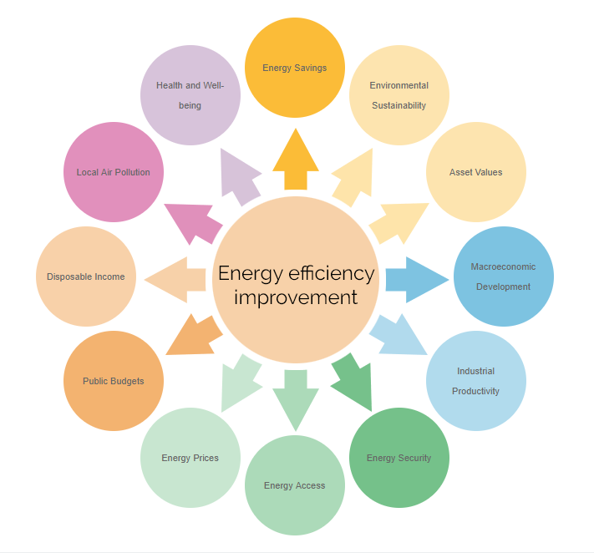
Multiple Benefits of Energy Efficiency: IEA
Copper. Makes the World Work Better
Notes:
I could spend many minutes speaking to this chart, which comes from the International Energy Agency on the multiple benefits of energy efficiency.
In summary, energy efficiency cuts across many economic and socio-economic areas.
Thinking back to my earlier slide on the UN SDGs, it can be said that clean energy is the thread that connects all 17 SDGs.
I invite you to visit IEA’s website to learn more about the many benefits of energy efficiency.
As an aside, the International Copper Association sits on the IEA’s Industry Advisory Board on Energy Efficiency.
Copper is the only material represented in this important group.

Slide 9

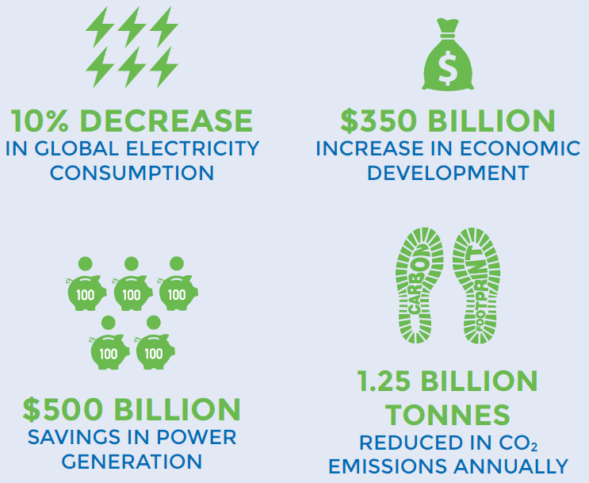



United For Efficiency (U4E)
Copper. Makes the World Work Better
Notes:
I could spend many minutes speaking to this chart, which comes from the International Energy Agency on the multiple benefits of energy efficiency.
In summary, energy efficiency cuts across many economic and socio-economic areas.
Thinking back to my earlier slide on the UN SDGs, it can be said that clean energy is the thread that connects all 17 SDGs.
I invite you to visit IEA’s website to learn more about the many benefits of energy efficiency.
As an aside, the International Copper Association sits on the IEA’s Industry Advisory Board on Energy Efficiency.
Copper is the only material represented in this important group.

Slide 10

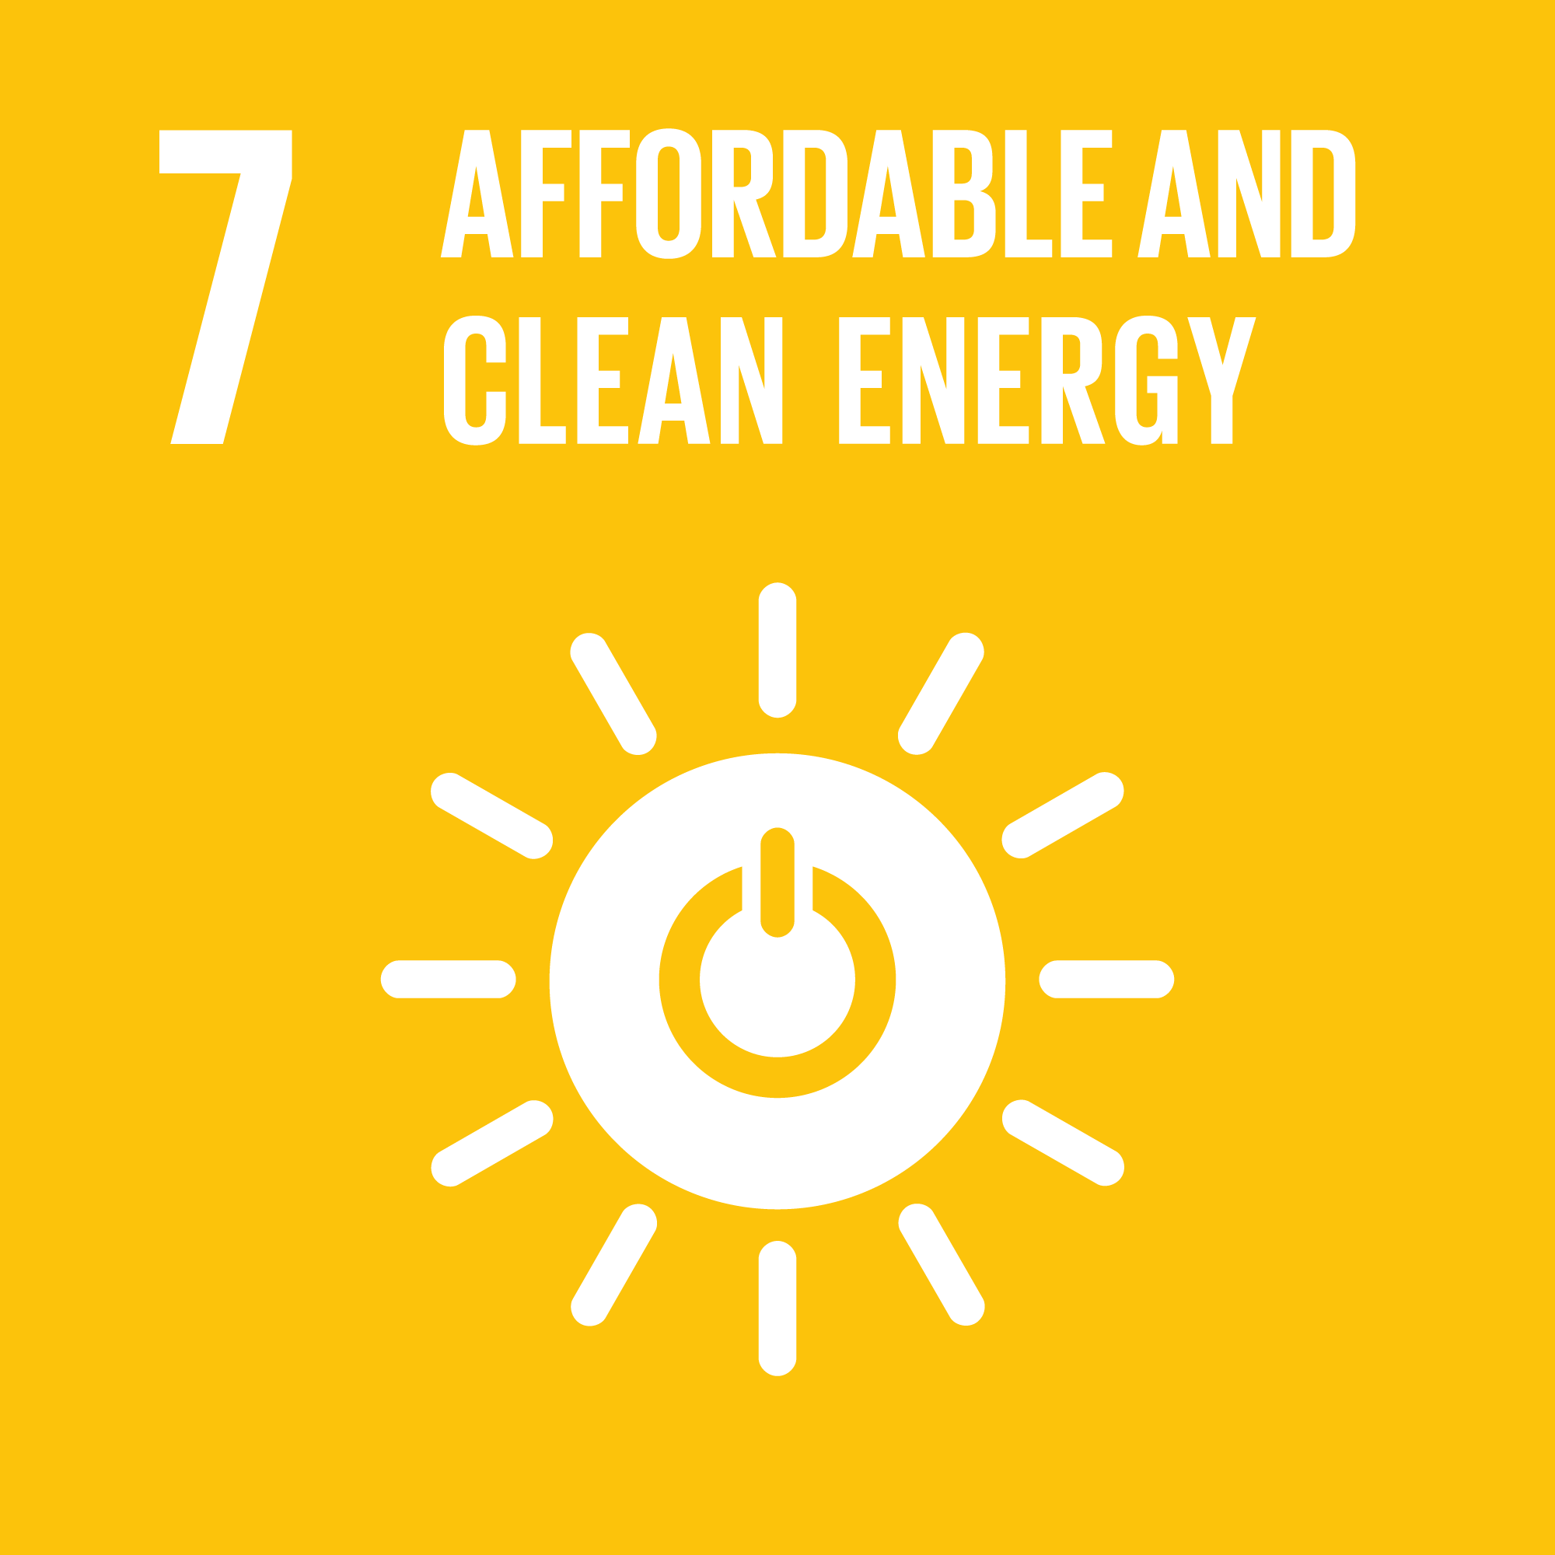


3% Club: Adopted by UN General Assembly
23 September 2019
3% Club
Notes:
And for many of our stakeholders, that is the book on copper and CO2
CLICK
Chapter one: One tonne of copper cathode equals 3.5 tonnes of CO2 emissions
CLICK
The end
CLICK
Much like the book on copper mining, the story of copper and CO2 cannot be told in only one chapter
CLICK
As was stated earlier, copper is the best nonprecious conductor of heat and electricity
CLICK
So, the products that contain copper tend to operate more efficiently
CLICK
A vast majority of copper – around 70% - is used in conductive applications that will benefit from copper’s higher efficiency
CLICK
In the end-use phase of these products, because of copper’s inherent efficiency, CO2 emissions are reduced between 100 and 7,500 tonnes! CLICK
CLICK
That’s a mitigation factor from primary to end-use emissions of between 30 and 2,000 to one! CLICK

Slide 11


Energy Efficiency Benefit:
Climate Change Mitigation
There are many sources of CO₂ emissions
Copper. Makes the World Work Better
Notes:
There are many sources of CO2 emissions
CLICK
Small
CLICK
And large
Forgive the basicness of this message, but it is important to set some context.

Slide 12
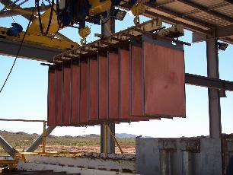
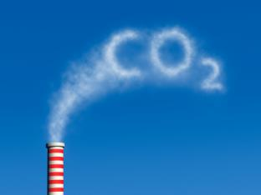
Copper and Climate Change
=
1 tonne
3.5 tonnes
Copper. Makes the World Work Better
Notes:
Of course, the copper industry emits CO2
CLICK
On average, to produce one tonne of cathode
CLICK
Our industry emits 3.5 tonnes of CO2

Slide 13
Copper and Climate Change
  Chapter One:
  One tonne of copper cathode = 3.5 tonnes of CO₂ emissions.
  The End
  The story of copper and CO₂ cannot be told in one chapter
  Copper is the best non-precious conductor of heat and electricity
  The products that contain copper tend to operate more efficiently
  A vast majority – 70% – of copper is used in conductive applications that benefit from copper’s efficiency
  In the end-use phase of these products, because of copper’s efficiency, CO₂ emissions are reduced by 100-7,500 tonnes
  That’s a mitigation factor of between 30 and 2,000-to-one!
Copper. Makes the World Work Better
Notes:
And for many of our stakeholders, that is the book on copper and CO2
CLICK
Chapter one: One tonne of copper cathode equals 3.5 tonnes of CO2 emissions
CLICK
The end
CLICK
Much like the book on copper mining, the story of copper and CO2 cannot be told in only one chapter
CLICK
As was stated earlier, copper is the best nonprecious conductor of heat and electricity
CLICK
So, the products that contain copper tend to operate more efficiently
CLICK
A vast majority of copper – around 70% - is used in conductive applications that will benefit from copper’s higher efficiency
CLICK
In the end-use phase of these products, because of copper’s inherent efficiency, CO2 emissions are reduced between 100 and 7,500 tonnes! CLICK
CLICK
That’s a mitigation factor from primary to end-use emissions of between 30 and 2,000 to one! CLICK

Slide 14
Copper and Climate Change
7,500 tonnes
100 tonnes
3.5 tonnes —
Notes:
That’s a massive mitigation of CO2
It’s difficult to show it graphically, but I will try
CLICK
This is the 3.5 tonnes of CO2 emitted to produce one tonne of copper cathode
CLICK
This is 100 tonnes of avoided emissions
CLICK
This is 7,500 tonnes of avoided emissions, which does not fit on the slide

Slide 15
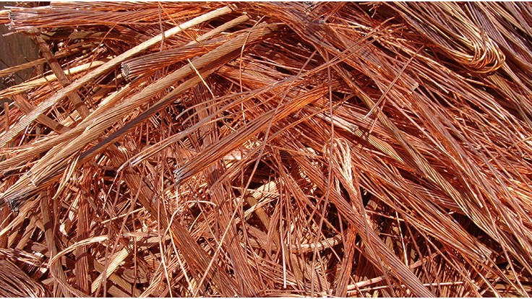
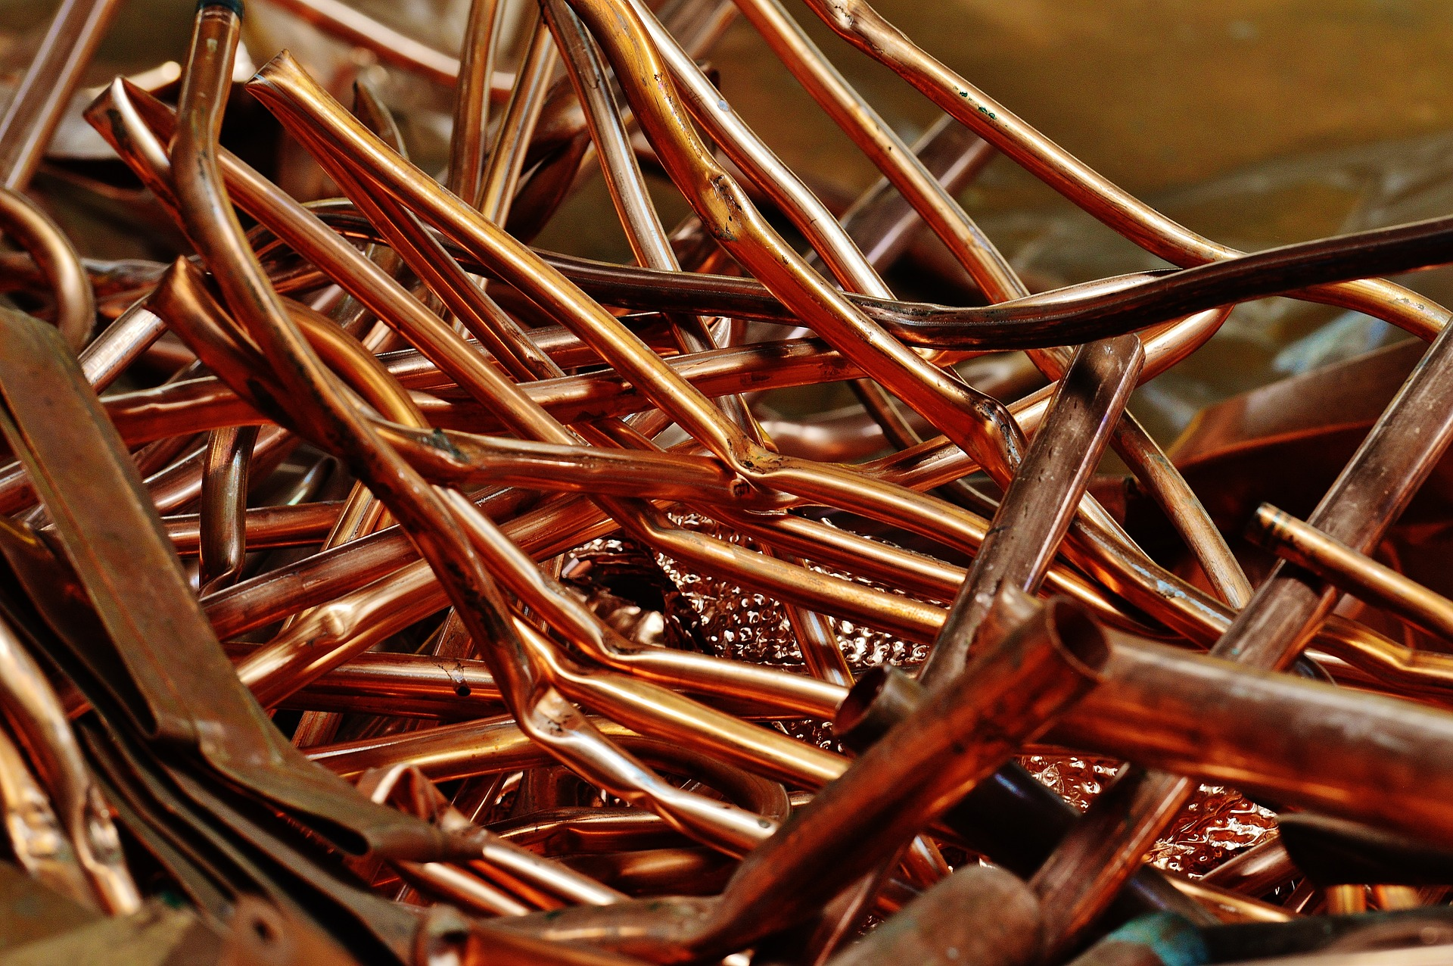
Copper and Circular Economy:
Infinitely Recyclable
Two-thirds of 600 million tonnes of copper produced since 1900 is still in productive use
One-third of demand today is met through recycling
True recycling v downcycling
Strong lifecycle footprint v other materials
Notes:
And for many of our stakeholders, that is the book on copper and CO2
CLICK
Chapter one: One tonne of copper cathode equals 3.5 tonnes of CO2 emissions
CLICK
The end
CLICK
Much like the book on copper mining, the story of copper and CO2 cannot be told in only one chapter
CLICK
As was stated earlier, copper is the best nonprecious conductor of heat and electricity
CLICK
So, the products that contain copper tend to operate more efficiently
CLICK
A vast majority of copper – around 70% - is used in conductive applications that will benefit from copper’s higher efficiency
CLICK
In the end-use phase of these products, because of copper’s inherent efficiency, CO2 emissions are reduced between 100 and 7,500 tonnes! CLICK
CLICK
That’s a mitigation factor from primary to end-use emissions of between 30 and 2,000 to one! CLICK

Slide 16
Responsible Sourcing

Slide 17
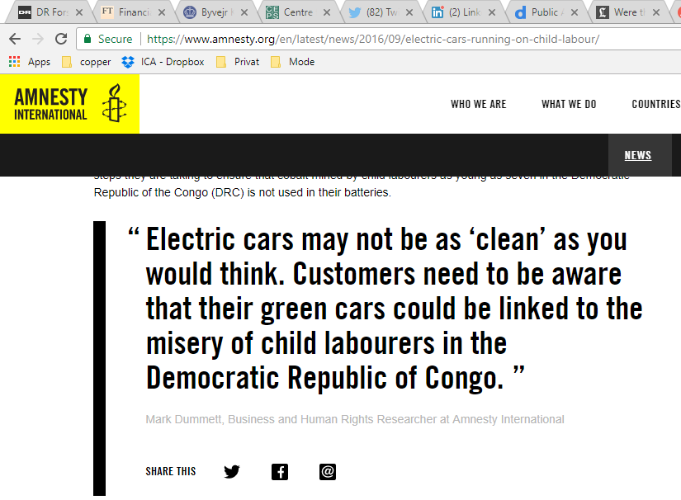
New Opportunities, More Challenges
Copper. Makes the World Work Better.
Notes:
The last part of this presentation focuses on Responsible Sourcing
In recent months and years, we have all seen a lot of attention given to how materials are sourced, and unfortunately the news around this is often not positive

Slide 18
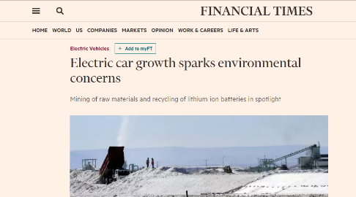
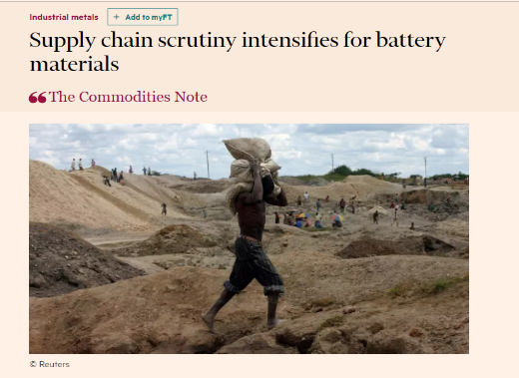
Responsible Sourcing
“Apple and Climate Change: Company Vows to Stop Mining and
Use 100 percent Recycled Material for the iPhone”
Copper. Makes the World Work Better.
Notes:
Pressure is coming from many directions, not the least of which is the large OEMs
As an example, Apple announced its intention to stop using mined materials and to use only 100% recycled materials in the iPhone
Whether or not this is realistically achievable is irrelevant; it speaks volumes to how a large and influential OEM views mining and mined materials

Slide 19

ICA Responsible sourcing strategy
Notes:
NOTE: much has happened since the first delivery of this presentation on 12 April 2019 and the notes below reflect recent updates
ICA’s members asked the organization to position them to meet the increasing challenges for the demand for responsibly sourced copper
After 1.5 years of engagement with its members, NGOs, OEMs, etc. in May 2019 ICA announced the launch of The Copper Mark
The Copper Mark is based on 31 criteria, underpinned by the UN SDGs, and a copper mining facility must demonstrate its performance against these criteria
Importantly, The Copper Mark was developed in collaboration with the LME, and we are pleased to report that companies qualifying for The Copper Mark will also qualify for the LME’s own responsible sourcing requirements
ICA is also working with the other large exchange to ensure compliance
The initial focus of The Copper Mark is upstream mining facilities; future versions will focus more downstream and will also take into account the use of recycled copper
Please visit www.sustainablecopper.org for more information.
ICA is planning activities at COP25 focused on The Copper Mark.

Slide 20
Thank you
For more information please contact
Steven.kukoda@copperalliance.org
Copper. Makes the World Work Better

