Slide 1
Green Solutions for the SGs

Slide 2
UN Multi-Sector Cooperation Platform for the Environment
Responds to demand by governments for stronger Science-Policy-Business interface
Solutions-based, multi-sector, cross-agency
Aligned with SDGs, Rio Conventions, UNEA Decisions
Self-governing, co-financed
Informs UNEA – direct access to decision making processes
Commitment to Circular Economy, Resource Efficiency, Nature-based Solutions
Thrives on gaps
Promotes Deployment of innovative Sust. Tech, supported by policy incentives + innovative financing
Promotes access to Big Data and a digital ecosystem for the planet, strengthened by one global partnership
New metrics for measuring performance aligned with SDG indicators

Slide 3
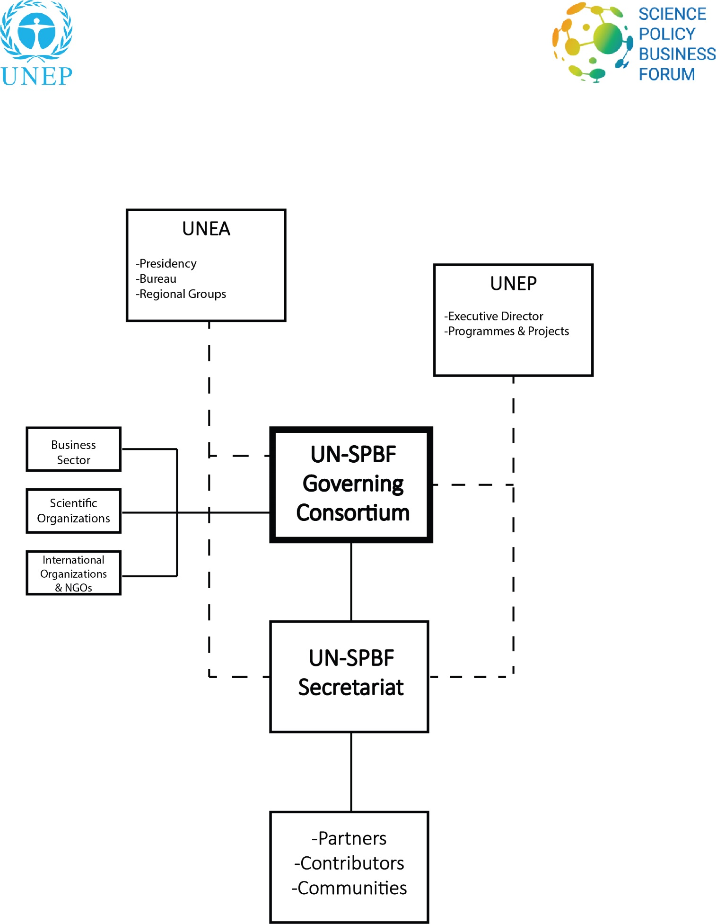
Structure

Slide 4
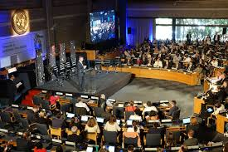
CONVENES
3000+
affiliated
institutions
worldwide

Slide 5
”
CONVENES
Technology giants
Start-ups at the forefront of innovation
Governmental organizations
Policy makers
Science Community
Citizen science
Civil Society

Slide 6
CONVENES
CONTRIBUTORS:
" A unique multi- stakeholder platform for green solutions ”

Slide 7
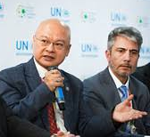
CONVENES
" A coalition of the Willing and a coalition of the Working ”
County Government of Kakamega
Government of Costa Rica

Slide 8
CONVENES
" Every member has something to bring to the table. ”

Slide 9
WHY?

Slide 10
Transformative Change for SDGs
Requires
Transformation in
How we Communicate
How We Work TOGETHER
Across Sectors, Across Boarders

Slide 11
Governments will not deliver SDGs alone
According to UNEP’s ‘Emissions Gap Report’
INDCs to deliver = ONE THIRD Emissions Reductions
Non-State Actors = TWO THIRDS

Slide 12
We all need to ‘own-up’
Ownership
Voice
Accountability
Equity
… of the problems and the solutions

Slide 13
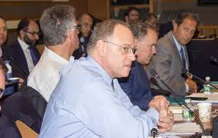
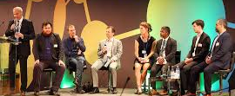
Science-driven,
evidence-based
decision making
Coherent policies
Market responses
Individual action
Forward-looking Impact-driven Widely networked Co-financed

Slide 14
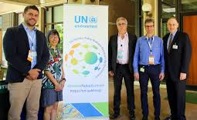
HOW?

Slide 15
Approach
Strengthen science, policy, business interface
Empower Sustainable
4IR
Promote Nature-based Solutions
Strengthen citizen science
Harness Frontier Tech for Good
Litter
Catalyze Growth of Green Tech markets

Slide 16
MULTI SECTOR APPROACH
Common decisions
Common goals
Differentiated roles
Market-driven interventions
Innovative Business models
Promote Sustainable Tech
Build Communities that work together based on co-benefits, goodwill, desire to do good
Mitigate Risk / Create Safeguards

Slide 17
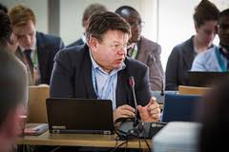
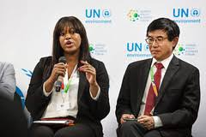
Tools to Catalyze Deployment of Green Tech. Solutions
Public Private Partnerships
Sustainable Public Procurement
Financial Tools
Access to Big Data
Transparency / Accountability
Better measurement and reporting

Slide 18
Milestone Events
" The Forum is fast evolving
into an incubator of innovation and joint initiatives and an accelerator of the circular economy"
March 2019
2nd Forum at UNEA-4
Big Data WG Inception
Oct 2018
-
Sept 2018
Earth Innovation Summit at Bureau
May 2018
Held in New York:
1st Steering Committee
-
-
Set the agenda Contributions to PoW
Held in Nairobi:
- Foundation Session
Dec 2017
Forum launch at UNEA-3

Slide 19
Impacts
NAIROBI
Dec 2017
NEW YORK
May 2018
TALLIN
Sept 2018
PARIS
Oct 2018
1st Forum Session
1st Steering Committee
Earth Innovation Summit
UNEA Bureau
UNEA Bureau invites Forum to advise on innovation, frontier technologies and resource efficiency.
Ministers advised to prioritize Big Data as key issue requiring support, financing and strategy
Inception of Big Data Working Group
An Extraordinary Session was hosted by the Government of France.
Key tracks: Big Data gaps, Earth observations and remote sensing, Governance, Equity and Ethics; Financing and opportunities in PPP, Opportunities offered by Artificial Intelligence and Machine Learning;
Forum Governing Consortium Established
Launch of Global Partnership for Citizen Science
The Forum’s Governing Consortium identified work streams to support in 2018-2019, in consultation with relevant UN programmes and sister agencies
Big Data and supporting a digital platform for open source access identified as top priority for intervention by the Forum

Slide 20
Impacts
Nairobi, March 2019
Ministerial Declaration unanimously stipulates a Big Data Strategy by 2025
Launch of Green Tech Startup Initiative
Govs request regional SPBF Fora linked to regional ministerial processes
Member States request Forum convenes during not ahead of UNEA for better interaction with Ministerial segment
Member States recognize the importance of the Forum convening on annual basis – including during UNEA gap year
New era begins

Slide 21
2019 – 2020 - 2022
Governing Consortium Scoping Meeting
NOV 2019, Canberra
Working Group on Big Data and Digital Platform for the Planet
NOV 2019, Seoul / Durban
Announcement of Regional SPBF - Africa and Asia-Pacific, to launch in 2020-2021
SEP 2020, Paris / Oslo
Third Global Session SPBF
GreenTech Marketplace
February 2021, UNEA, Nairobi
SPBF UNEA Session
2021
2022, Stockholm / NBO
Stockholm + 50 SPBF Special Edition

Slide 22
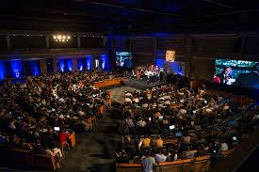
2020
1-6 September
3rd Global Session UNEP Science-Policy-Business Forum World Green-Tech Marketplace

Slide 23
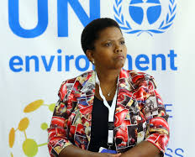
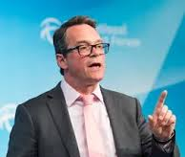
Inspire by ‘Doing’
Launch transformative market-led initiatives
PPP + Sustainable Public Procurement Deployment of sustainable Tech
supported by innovative financing options
Lend voice and prominence
to transformative leadership across sectors
Mobilize towards UNEA 5
Rally multi-sector support behind UNEA-5 & Implementation of Resolutions

Slide 24
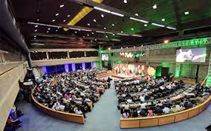
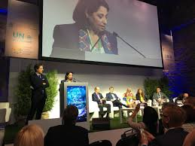
ADVANTAGES
Powerful
Timely
Dynamic
Diverse communities working together
Addresses many existing gaps
Fast-acting, impact-oriented
Safeguards against inaction
Balanced
Aligned with Environment and International Cooperation Frameworks

Slide 25
OPPORTUNE TIMING
Six months ahead of UNEA-5 in 2021: enhance multi-sectoral collaboration towards UNEA-5, where Forum initiatives will contribute to UNEA planning
Two months ahead of the Climate COP
One month ahead of the Biodiversity COP
Weeks ahead of the General Assembly
3 months following the IUCN World Conservation Congress

Slide 26
UN-SPBF Key Streams
Global Platform for Big Data on the environment
Science for Decision-Making: Shaping Policies and Market Responses
Explore opportunities offered by AI and machine learning; Big Data, earth observation and remote sensing
Governance
Equity and ethics
Financing
-
Review latest recommendations from flagship environmental assessments and White Papers by Partners
Discussions on the required policy responses/actions by policy makers, the private sector and key stakeholders.
1
-
2
Redesigning Metropolis: Smarter, Greener Solutions for Cities
3
Leverage innovative technologies to tackle urban challenges and encourage the efficient use of natural resources
Review latest in environmentally sound design and infrastructure
Encourage positive resourcing and procurement decisions
In support of Environment
Dimension of SDGs
4
Launch Green-Tech Start-up Hub
Identify, communicate and shed light on innovative solutions and technologies by this fast-growing sector
Identify and encourage enabling policies
Bridge the technology and policy divide
Encourage investment in green tech
Climate Challenge and Non-State Actors: From Transparency to Leadership
5
6
Empower private sector transparency and leadership to tackle climate change
Review mechanisms to monitor, measure, verifying and report on emissions reductions by industry and non-state actors
Examine how policy and incentives can regulate and strengthen such reporting
Examine how the future Emissions Gap Report will measure and analyse action by non-state actors
Sustainable Food for a Healthy Planet
-
Agricultural transformation: sustainable and climate-smart agricultural models minimizing impacts on pollution
Nutrition and healthy diets: embracing difficult questions and debates about meat vs. vegetarian diets, considering biofortification, plant health
Food waste: measuring and achieving reduction target at global level
-
-

Slide 27
KEY NITIATIVES

Slide 28
KEY INITIATIVES
1. Big Data & AI for the Planet
NY- PARIS – NAIROBI- CANBERRA
UNEA Declaration
Pioneering White Paper
Establishment of Working Group on Big Data
Convening and Partnership Arm of Data Strategy
3 Pilot Projects with IBM and UN Situation Room
Use Cases : Establishing Poaching Patterns
using Big Data and AI

Slide 29
KEY INITIATIVES
2. From Nitrogen Cycle Pollution To Nitrogen Circular Economy
To make nitrogen usable, it must be converted into other forms of reactive nitrogen
MULTI-SECTOR ALLIGNMENT
COOPERATION WITH INTERNATIONAL NITROGEN INITIATIVE
FOCUS ON AGRICULTURAL SECTOR
INNOVATION
FINANCE

Slide 30
KEY INITIATIVES
3. SUSTAINABLE FOOD SYSTEMS
Food-Waste –Energy Nexus
Resource Efficiency in Agriculture
MULTI-SECTOR ALLIGNMENT
FROM CLIMATE-EFFICIENCY TO RESOURCE EFFICIENCY
LAND-USE & FINANCE

Slide 31
KEY INITIATIVES
4. New metrics for measuring performance aligned with SDG indicators

Slide 32
KEY INITIATIVES
5. Green-Tech Startup Hub
Launched at the Second Global Session of the Forum, the Hub brings together promising technology-led and nature-based solutions for the environment.
A draft white paper on the enabling conditions required to strengthen innovation – especially by young people – is in the pipeline.
The hub hopes to encourage investment and the development of sound policies to support growing green tech markets in that sector

Slide 33
KEY INITIATIVES
New
6. Private sector initiatives for biodiversity targets
7. Combating Marine Litter

Slide 34
Guiding Principles
Accountability
Transparency
Ethics
Equity
Shared-Responsibility
Commitment to UNEP’s mandate, UN Principles
Commitment to SDGs and Env mandate

Slide 35
INSTITUTIONAL INSTRUMENTS
UN Reform and Common System
UN/UNEP Partnership Processes
Legal Instruments
Ethic / Code of Conduct
Strategy on Private Sector Engagement
Science Strategy
Other

Slide 36
RISK
Trade tensions,
Politics …
Ethics / Trust
Green-Washing
Equity
Lobbying

Slide 37
Safeguards
Inclusion
Ethics
Reporting
Oversight
Due Diligence
Balance

Slide 38
