Slide 1
Green Solutions for the SGs

Slide 2
UN Multi-Sector Solutions Platform for the Environment
Responds to demand by governments for stronger Science-Policy-Business interface
Solutions-based, multi-sector, cross-agency
Aligned with SDGs, Rio Conventions, UNEA Decisions
Self-governing, co-financed
Informs UNEA – direct access to decision making processes
Commitment to Circular Economy, Resource Efficiency, Nature-based Solutions
Thrives on gaps
Promotes Deployment of innovative Sust. Tech, supported by policy incentives + innovative financing
Promotes access to Big Data and a digital ecosystem for the planet, strengthened by one global partnership
New metrics for measuring performance aligned with SDG indicators

Slide 3
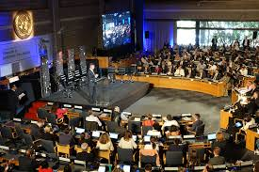
CONVENES
3000+
affiliated
institutions
worldwide

Slide 4
”
CONVENES
Technology giants
Start-ups at the forefront of innovation
Governmental organizations
Policy makers
Science Community
Citizen science
Civil Society

Slide 5
CONVENES
CONTRIBUTORS:
" A unique multi- stakeholder platform for green solutions ”

Slide 6
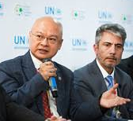
CONVENES
" A coalition of the Willing and a coalition of the Working ”
County Government of Kakamega
Government of Costa Rica

Slide 7
CONVENES
" Every member has something to bring to the table. ”

Slide 8
Transformative Change for SDGs
Requires
Transformation in
How we Communicate
How We Work TOGETHER
Across Sectors, Across Boarders

Slide 9
UN Working Group on Big Data and Digital Ecosystem for the Planet

Slide 10
Strengthen and align global efforts to develop an integrated, UN-hosted, open source digital platform to manage and share authentic and valid environmental data for decision making to set society on a pathway to achieving SDGs and internationally agreed targets
UN WORKING GROUP ON BIG DATA AND DIGITAL ECOSYSTEM FOR THE PLANET
PURPOSE

Slide 11
UN Working Group on Big Data and Digital Ecosystem for the Planet

Slide 12
CONTEXT
At the inaugural meeting of the UN Science Policy Business Forum in Nairobi in December 2017, need for integrated UN Big Data Platform took centre stage.
Six specialized sessions lead by environmental and data experts, earth observation scientists and technology giants provided fertile ground to reflect on what we have, what we do not have, where we want to be
The right people at the right time in the right place.
We needed more of that.
In May 2018, at the First Scoping Meeting of the Governing Consortium of the Forum, the decision to form a working group on Big Data and Frontier Tech was born
Paris offered to host the inaugural meeting to launch the group in Oct 2018
NAIROBI
Dec 2017
NEW YORK
May 2018
1st Forum Session
1st Steering Committee
Forum Governing Consortium Established
Launch of Global Partnership for Citizen Science
The Forum’s Governing Consortium identified work streams to support in 2018-2019, in consultation with relevant UN programmes and sister agencies
Big Data and supporting a digital platform for open source access identified as top priority for intervention by the Forum

Slide 13
CONTEXT
The Estonia Presidency of UNEA showed great leadership, convening a Ministerial Bureau that offered the Forum an unprecedented opportunity to help inform decision making and bring top experts and business partners to the table.
In Paris, the inception of the Working Group took place supported by IRD, CNES, ALLENVI and many institutions who welcomed over 120 global experts convened by the Forum.
The Draft Ministerial Declaration on Big Data was drafted in preparation for UNEA 4 with support and participation of the experts
A new era of cooperation and consultation has begun
TALLIN
Sept 2018
PARIS
Oct 2018
Earth Innovation Summit
UNEA Bureau
UNEA Bureau invites Forum to advise on innovation, frontier technologies and resource efficiency.
Ministers advised to prioritize Big Data as key issue requiring support, financing and strategy
Inception of Big Data Working Group
An Extraordinary Session was hosted by the Government of France.
Key tracks: Big Data gaps, Earth observations and remote sensing, Governance, Equity and Ethics; Financing and opportunities in PPP, Opportunities offered by Artificial Intelligence and Machine Learning;

Slide 14
Timeline
NY- TALINN- PARIS – NAIROBI- CANBERRA
GC Decision, NY May 2018
Ministerial Briefing, Tallinn Sept 2018
Establishment of Working Group on Big Data, Paris Oct 2018
First Discussion Paper Released, Paris, Oct 2018
First Working Group Meeting, Nairobi, March 2019
Ministerial Declaration on Big Data Strategy, March 2019
Second Working Group Meeting, Canberra Nov 2019

Slide 15
Distilled conclusions from past consultations
www.un-spbf.org
SPBF Working Group in March 2019 adopted a discussion paper: “The Case for a digital ecosystem for the environment” which explores the benefits, risks and governance challenges associated with creating and maintaining such a digital ecosystem
An action plan needs to be put together for review by March 2020
The availability of high-quality, timely and disaggregated data is vital for evidence-based decision-making and to ensure accountability for implementation of the 2030 agenda

Slide 16
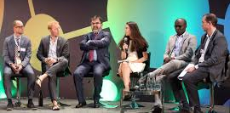
Environmental policies depend on the timely and reliable availability of integrated geospatial, earth observations and remote sensing, real-time satellite imagery, information and knowledge that needs to be harvested and shared.
UNEP has been mandated to develop with partners, including GEO, a long-term strategy for the collection, storing, sharing, access and use of global environmental data using the latest technologies.
Addressing the challenges in Big Data and science involves promoting a global partnership to address gaps, overcome challenges, build on strengths, harness finance and technology and avoid fragmentation.

Slide 17
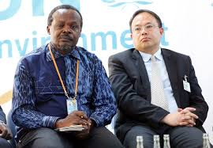
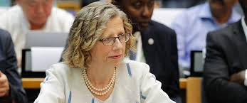
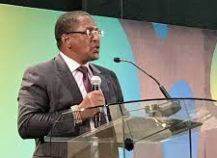
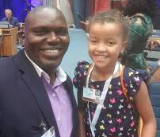
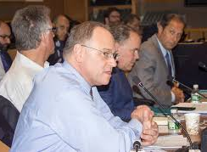
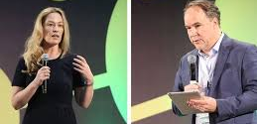

Slide 18
UN Working Group on Big Data and Digital Ecosystem for the Planet
Approach
& Key Objectives

Slide 19
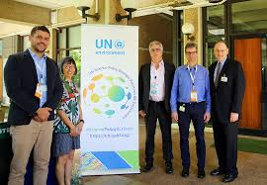
1- Harness the ongoing data and technology revolution 2- Ensure the authenticity and validity of data to support sustainable development, 3- Address Data Gaps 4- Boost multi-sector and cross agency cooperation, 5- Transform capacities to address challenges and accelerate progress towards sustainable development
APPROACH
& KEY OBJECTIVES

Slide 20
6- Create a global partnership for Big Data and Digital platform for the planet 7- Define the scope and type of Big data and technologies required to achieve the global goals and environmental targets 8- Catalyze the deployment of technologies required to achieve agreed goals 9- Empower citizen science 8- Take bold, urgent , sustained, inclusive and transformative, integrated action
UN WORKING GROUP ON BIG DATA AND DIGITAL ECOSYSTEM FOR THE PLANET
APPROACH & KEY OBJECTIVES

