Slide 1
UNEA-4 Ministerial Declaration: empowering environmental data
#SolveDifferent
Ado Lõhmus
Permanent Representative of Estonia to the UNEP
Environment Attache of Estonia to the EU
6.11.2019

Slide 2
Theme of the UNEA-4
Innovative Solutions for Environmental Challenges and Sustainable Consumption and Production
Notes:
Hard to find consensus, need to focus – main enabler

Slide 3
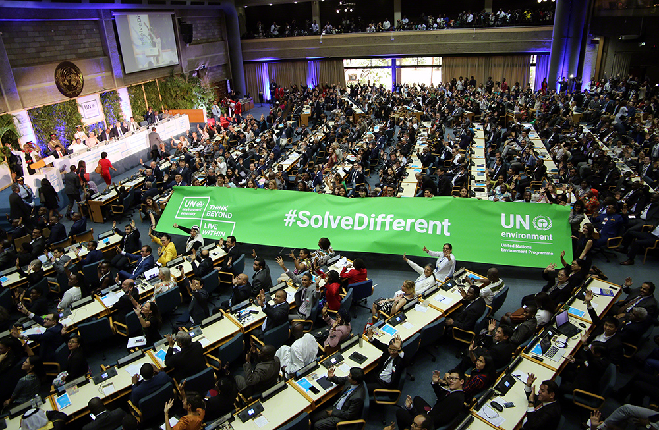

Slide 4
Main priorities from the beginning
1: transparency, accountability and comparability of global environmental data and develop science-policy-business partnerships on innovative data technologies and digital solutions.
2: sustainable and efficient resource management
3: robust engagement of civil society, citizens, private sector and academia

Slide 5
Key elements for data priority
global environmental data policy and common data standards
access to and exchange of data
monitoring systems, satellite data
artificial intelligence and big data analysis
scenario models for environmental foresights
product information, factsheet, knowledge on resource use and productivity
citizens science
national capacities for data management
science-policy-business partnerships
Notes:
global environmental data sharing policy by 2021
common standards for providing and sharing environmental data
strengthen existing and establish new comprehensive environmental monitoring systems
improve data analysis and scenario-building models to develop environment foresights, including on food security, marine litter, biodiversity loss, desertification
improve the integrated analysis of environmental data from traditional and new sources, including remote sensing, citizen science, and increase the use of artificial intelligence and big data analysis to support the development of solutions for sustainability.
strengthen national capacities for environmental data management and request special programme for capacity building on global environmental data management.
improve or develop comparable digital solutions on product transparency, including labelling systems, product resource passports, product environment footprint and life-cycle assessment models

Slide 6
Obstacles vs Courage
too digital, too Estonian!
sharing data?
access to data?
common standards?
lack of capacity!
enganging citizens?
Notes:
Estonia = ICT: pros and cons

Slide 7
Mandate by 193 environment ministers at UNEA-4 in Nairobi
support the UNEP in developing a global environmental data strategy by 2025
comparable international environmental data
promoting the use and sharing of environmental data
develop national environmental data management capacities (e.g monitoring systems and technologies)
promote the use of data analysis models to develop environment foresights
promote wider use of innovative approaches, such as inclusive citizen science
disclosure of appropriate product information to consumers and develop measures to increase transparency in product chains
Notes:
Comparable = standards
Support UNEP = funds, and collaboration
Foresights - national and local preparedness and responses to mitigate environmental degradation and risks from disasters and conflicts
Appropriate product information! Not all

Slide 8
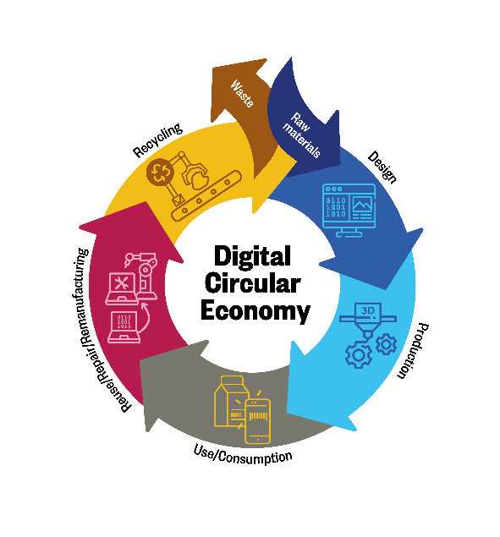
Further elaborations
Digital solutions for circular economy
Sustainable financing
Natural capital accounting
Environmental performance indicator

Slide 9
We did it!ble Development

Slide 10
Thank you!

