Slide 1
Addressing Data Gaps for the SDGs
Professor gavin shaddick
Alan turing institute & University of Exeter

Slide 2
Environment-related sdgS
Addressing Data Gaps for the SDGs
93 environment-related SDGs indicators
insufficient data to assess progress for 68%
(Measuring Progress, UNEP 2019)
Lack of comprehensive geospatial data
Data is often out of date for decision making
Issues with methodologies and data integration
Consistency over time
Lack of disaggregated information on (especially gender specific) environmental data

Slide 3
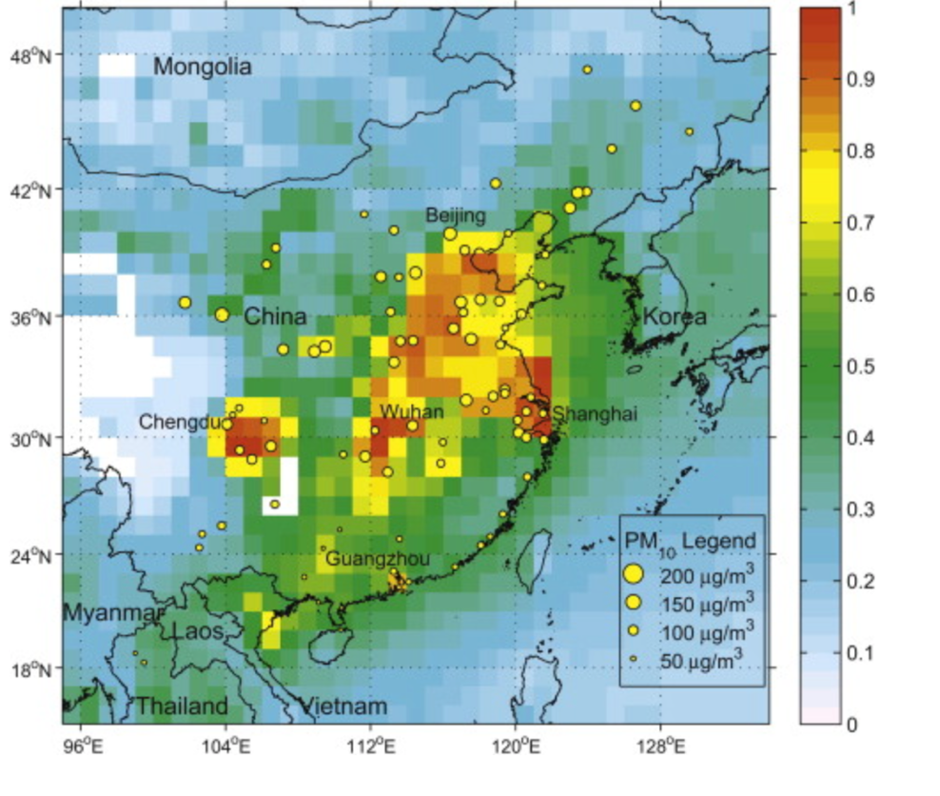
What data do we have?
Addressing Data Gaps for the SDGs
Multiple sources
national, regional, global
Multiple scales
Spatial and temporal coverage
Multiple measures / proxies
Different biases and uncertainties

Slide 4
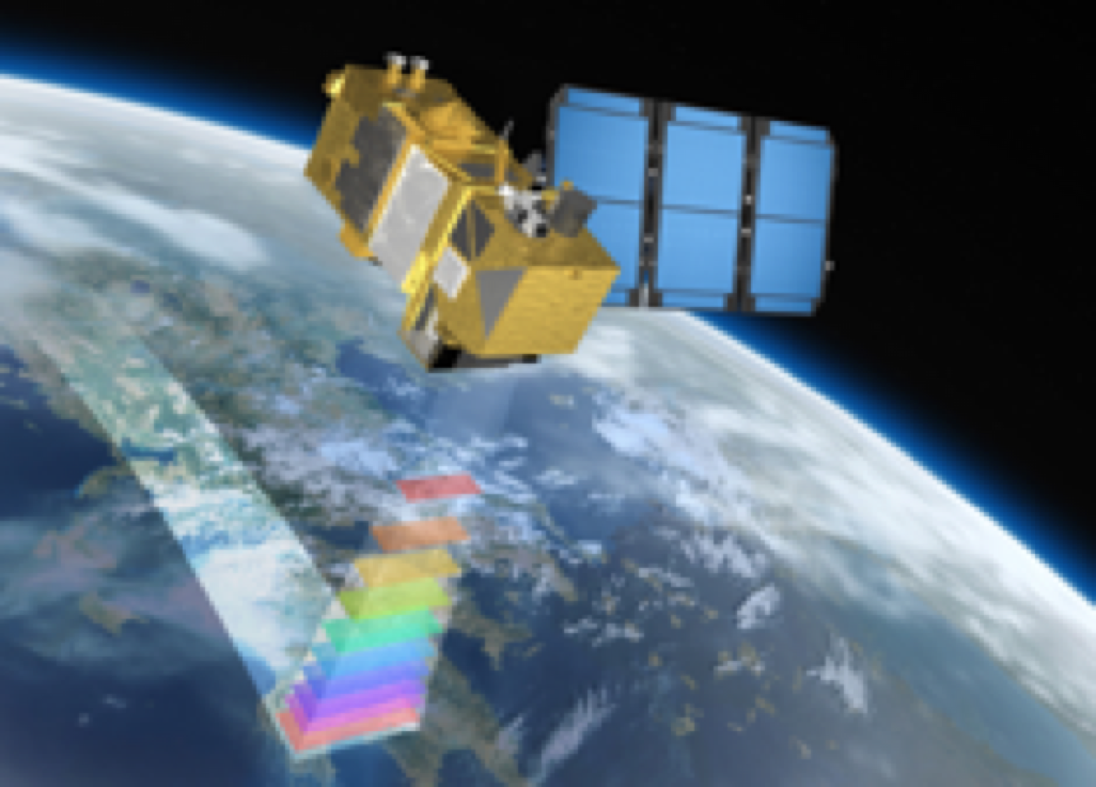
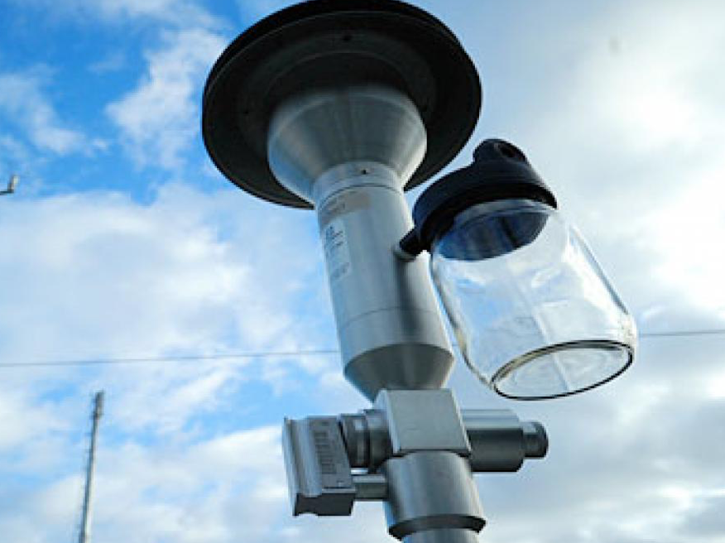
Where does it come from?
Addressing Data Gaps for the SDGs
Rapid increase in number, and variety, of data sources
Data quality
Data accessibility
Data journey
May be using data for reasons other that those for which it was intended
Data collection mechanisms
Pre-processing

Slide 5
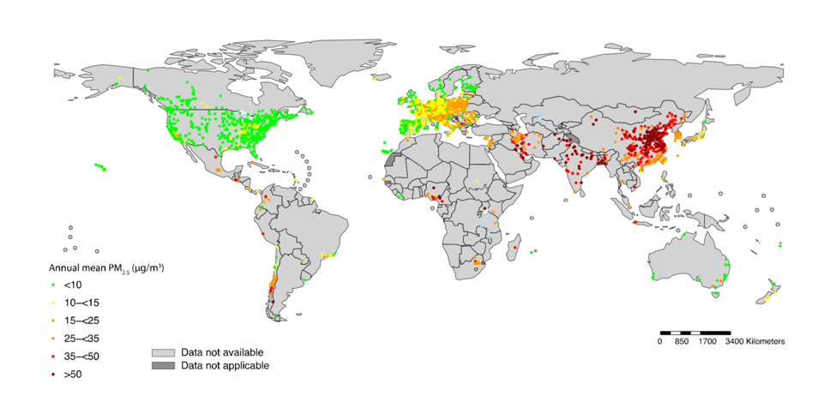
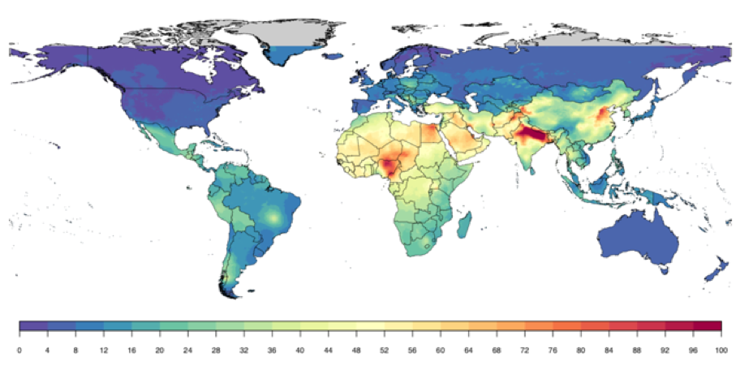
Example: SDG 11.6.2
Addressing Data Gaps for the SDGs
Ground monitoring is limited in many areas of the world
Can utilise information from multiple sources: satellite remote sensing, chemical transport models, land-use information
Data Integration Model for Air Quality

