Slide 1
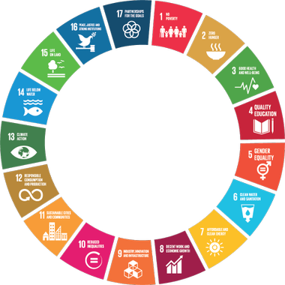
Towards a Global Strategy on Big Data For the Environment
Group on Earth Observation – 2019
Canberra, Australia
Notes:
What I’m going to talk about here is not about a simple data platform.
This about achieving sustainable development.
Why is this so important? By definition, what is not sustainable will unsustainable, i.e. will be unsuitable for the people and for the environment. And if you think that being amongst the richest in the most develop country will save you. I will ask you to think again.

Slide 2
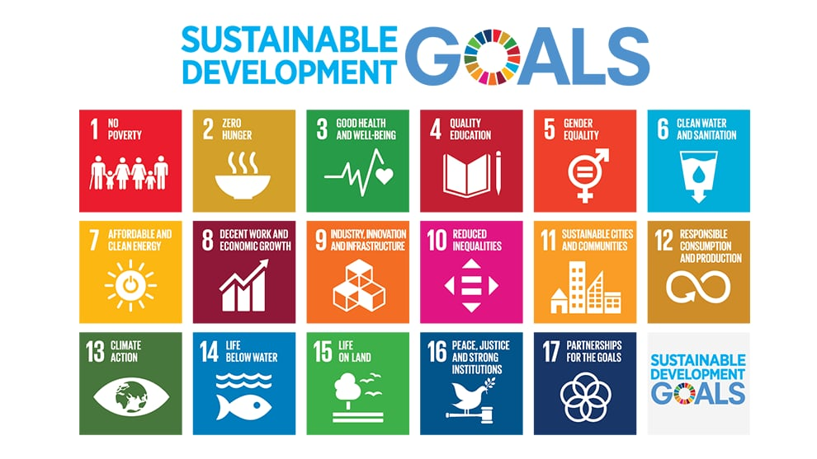
Designing a strategy depends on your goal(s)
Notes:
Designing a strategy depends on your goal. It is a fundamental question which is arguably the most important challenge ever faced by humanity.
Which is: How to achieve sustainable development

Slide 3
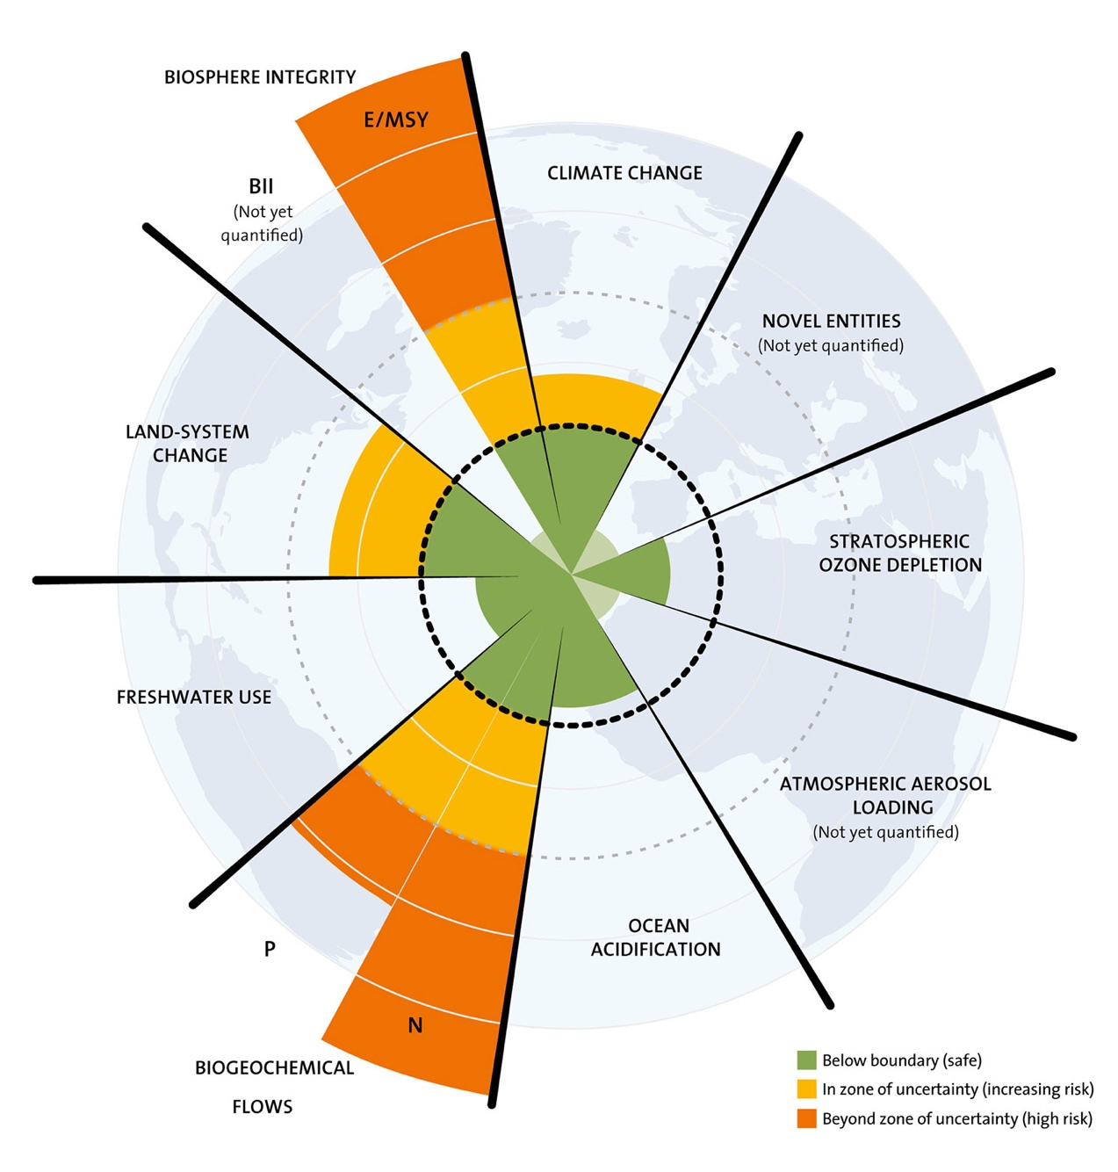
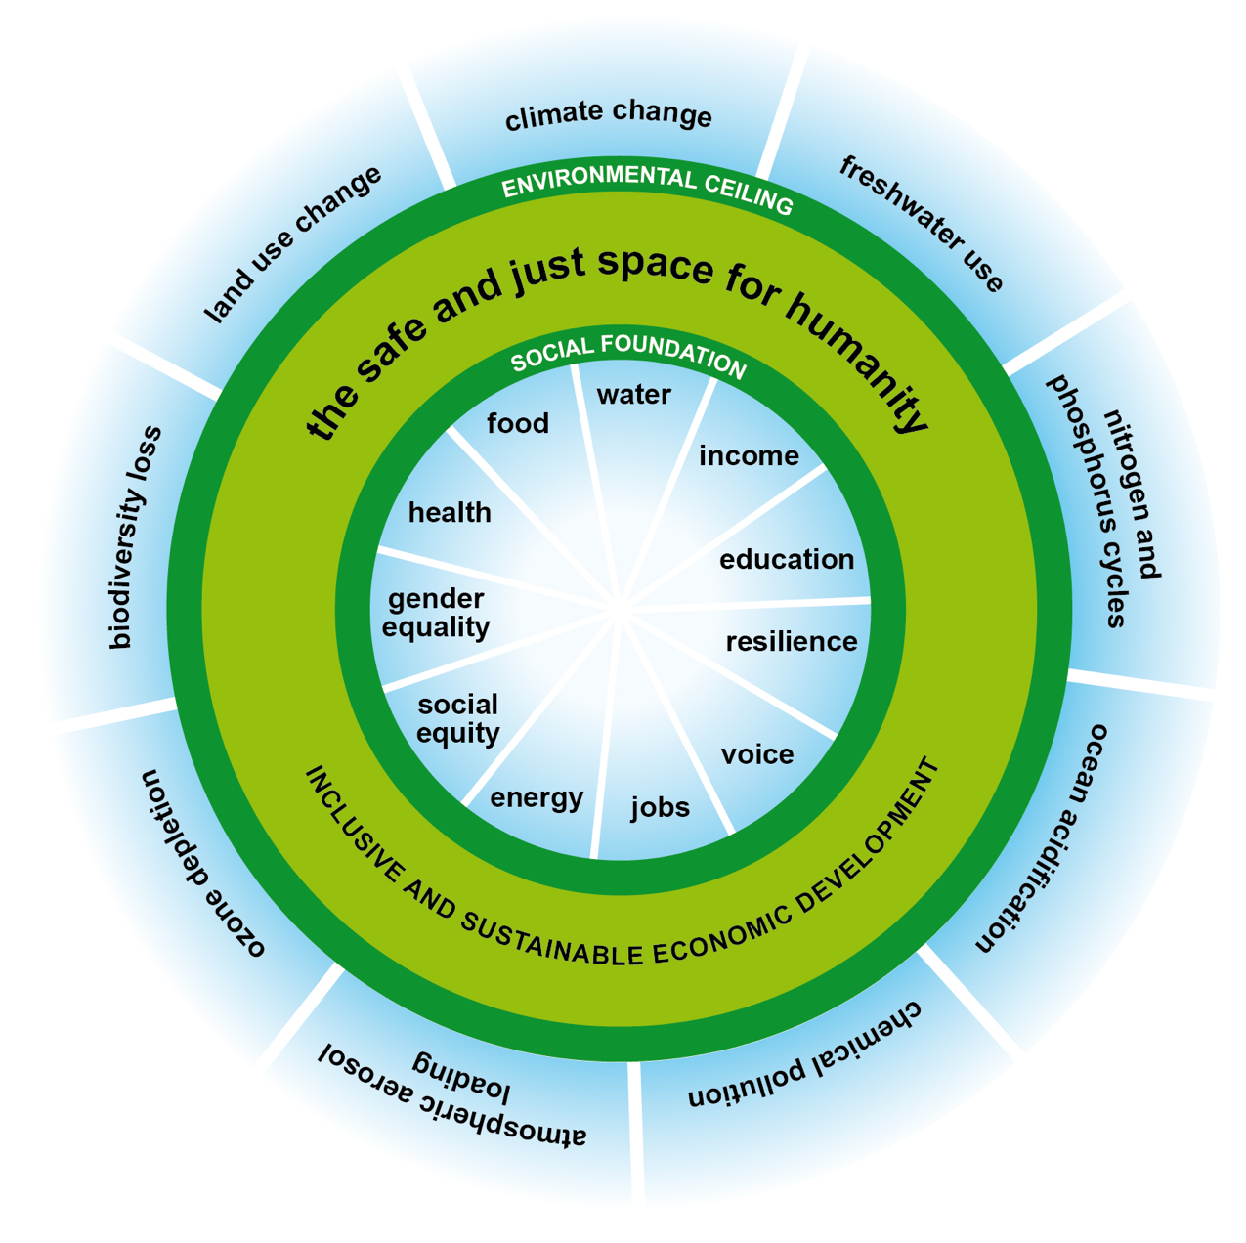
Kate Raworth
Notes:
This is the biggest challenge ever. Because we need to respect the Earth System to remain withing the same operating space. Out of the 9 PBs identified by Johan Rockström 4 boundaries have been exceeded, 2 cannot yet be defined, and only 3 are currently respected, but already one of them is on a quick trend to be exceeded.
At the same time

Slide 4
Notes:
It is a fundamental question which is arguably the most important challenge ever faced by humanity.
Out of the 9 PBs identified by Johan Rockström 4 boundaries have been exceeded, 2 cannot yet be defined, and only 3 are currently respected, but already one of them is on a quick trend to be exceeded.
At the same time

Slide 5
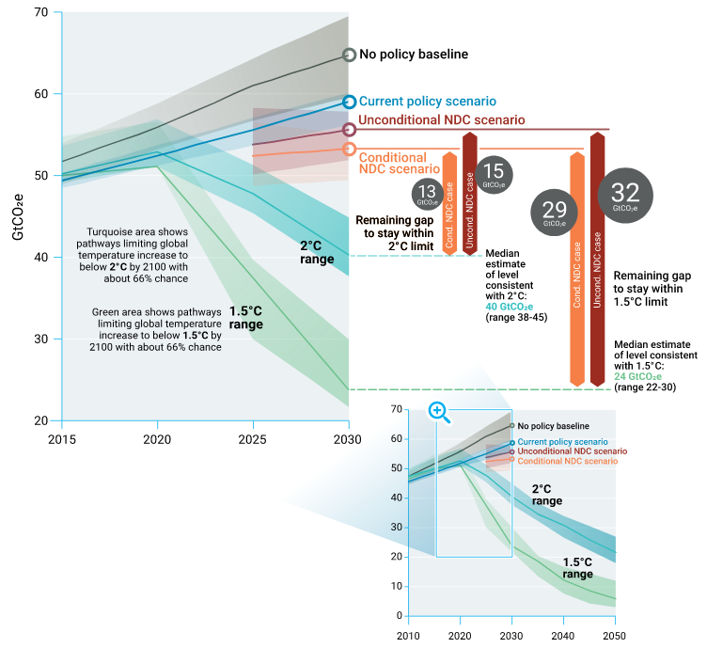
Drastically reducing GHG emissions
Emissions Gap Report 2018
Notes:
I fail to feel the appropriate level of alarm in government, industry and financial sector.

Slide 6
Context: Increase World population
9.7 billions in 2050
Notes:
The natural growth of population continuously presents problems for the preservation of the environment, and adequate policies and measures should be adopted, as appropriate, to face these problems. Declaration of the United Nations Conference on the Human Environment
1972… since then the population doubled.

Slide 7
Population increase 2017-2050
Billion

Slide 8
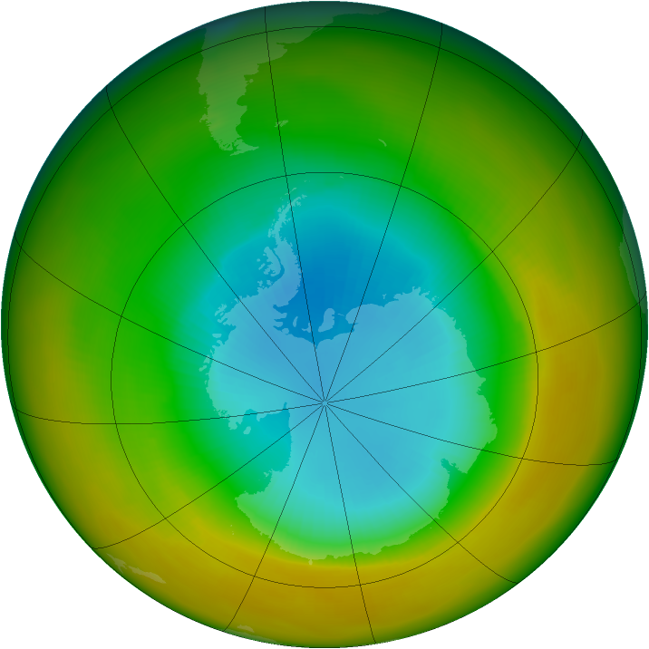
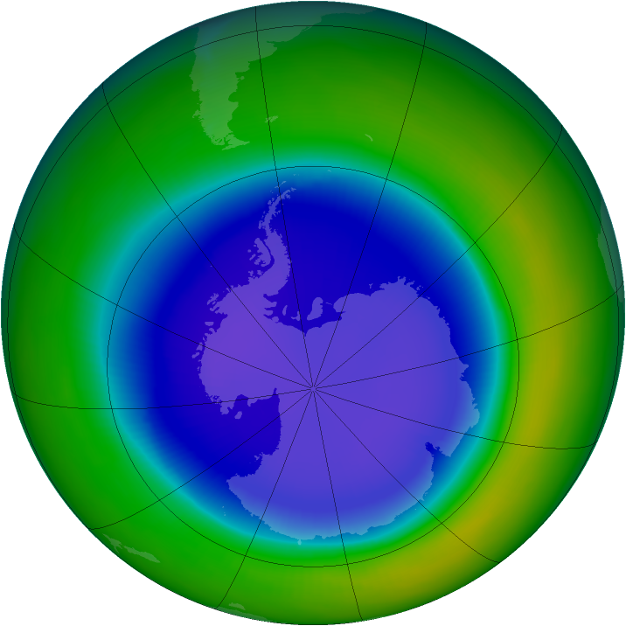
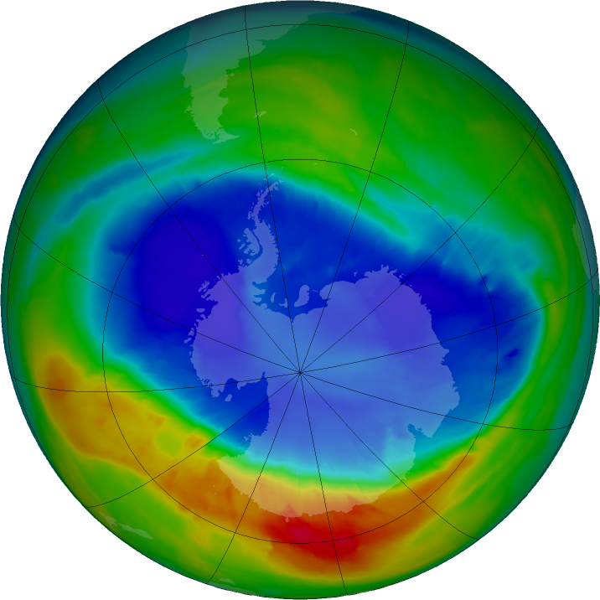
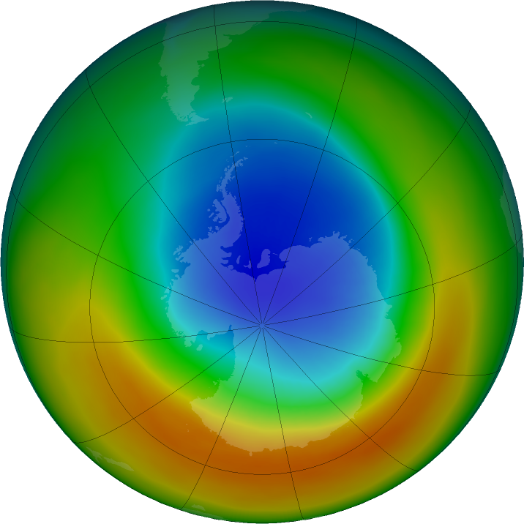
Stratospehric Ozone Depletion
million km²
Notes:
Data allowed the detection of issues. But it took industry, government and scientists to work together to taken actions. Thanks to the Montreal Protocol, we appear to be on the path that will allow us to stay within this boundary.

Slide 9
BIODIVERSITY
Notes:
Loss of biosphere integrity (biodiversity loss and extinctions) The Millennium Ecosystem Assessment of 2005 concluded that changes to ecosystems due to human activities were more rapid in the past 50 years than at any time in human history, increasing the risks of abrupt and irreversible changes. We are observing the sixth mass extinction in the earth’s history at a rate exceeding 1000 times the natural rate.
Use blockchain for traceability of label of sustainable wood production

Slide 10
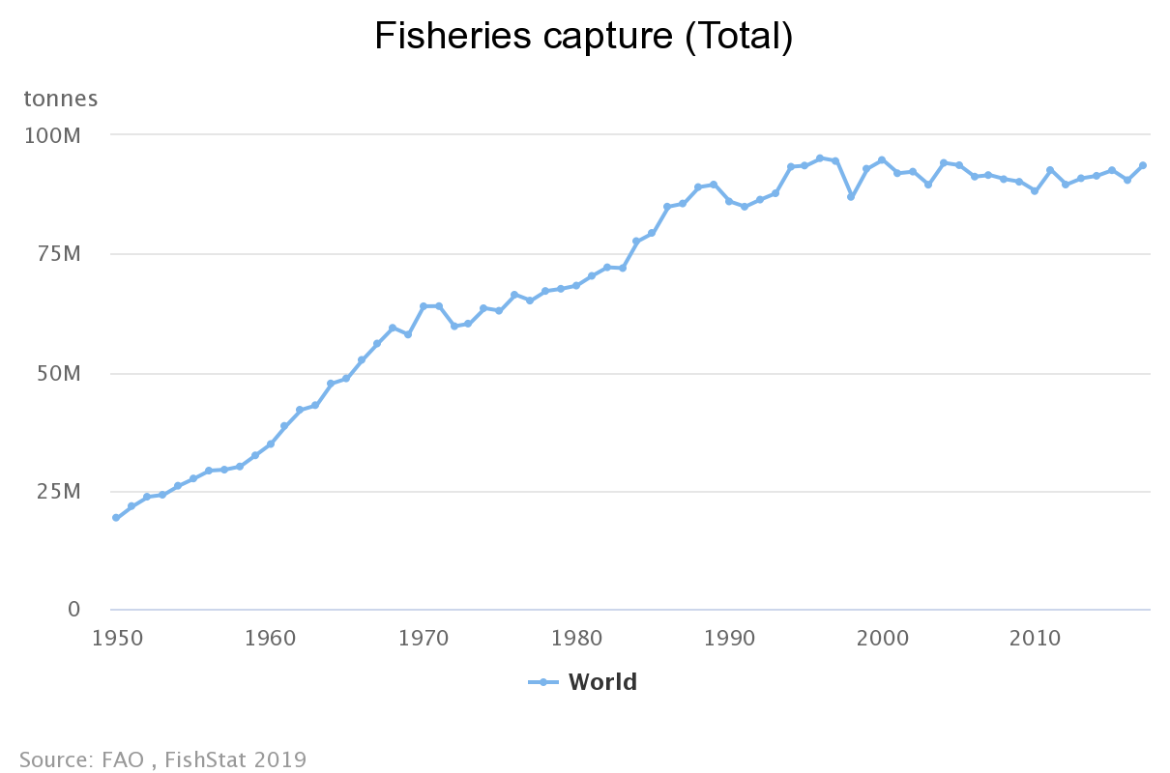
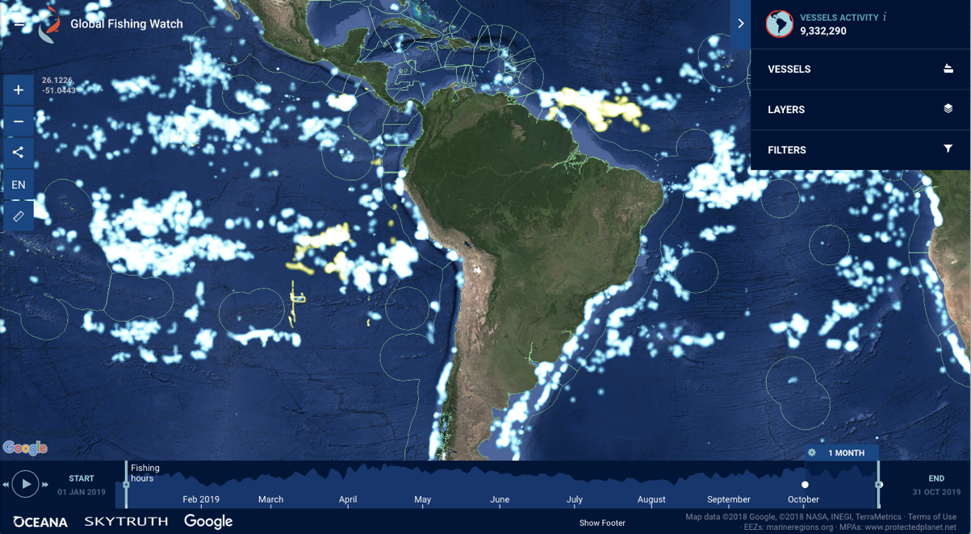

Slide 11
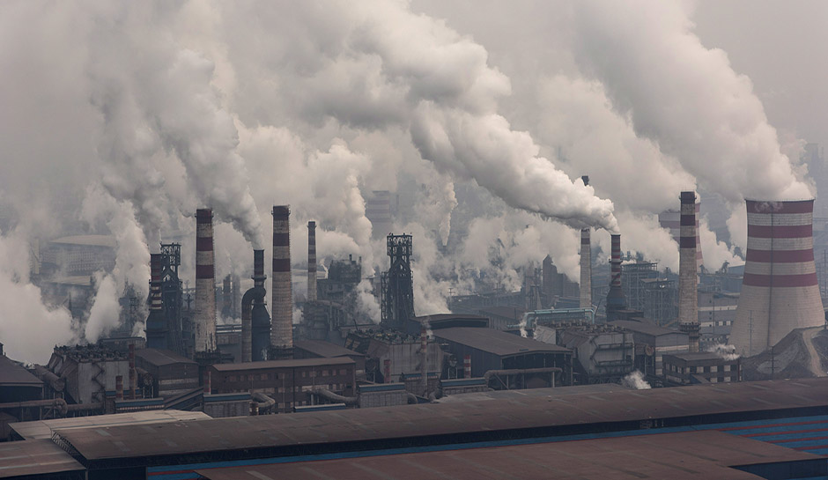
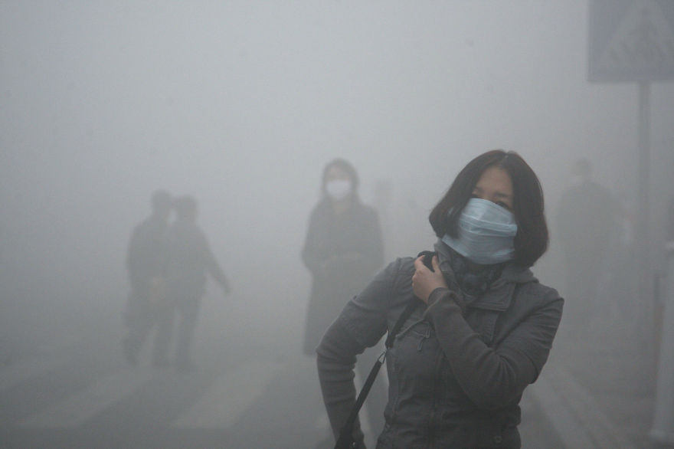
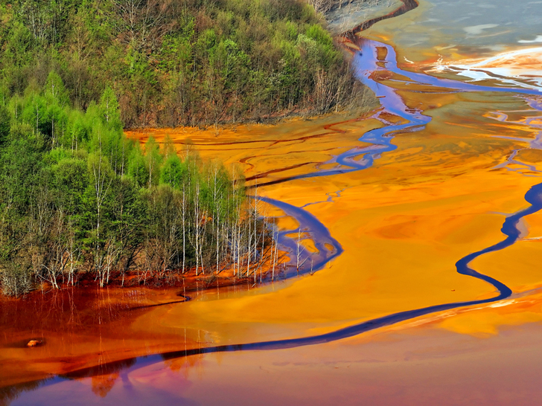
Chemical pollution
Notes:
Emissions of toxic and long-lived substances such as synthetic organic pollutants, heavy metal compounds and radioactive materials represent some of the key human-driven changes to the planetary environment. These compounds can have potentially irreversible effects on living organisms and on the physical environment (by affecting atmospheric processes and climate). At present, we are unable to quantify a single chemical pollution boundary.

Slide 12
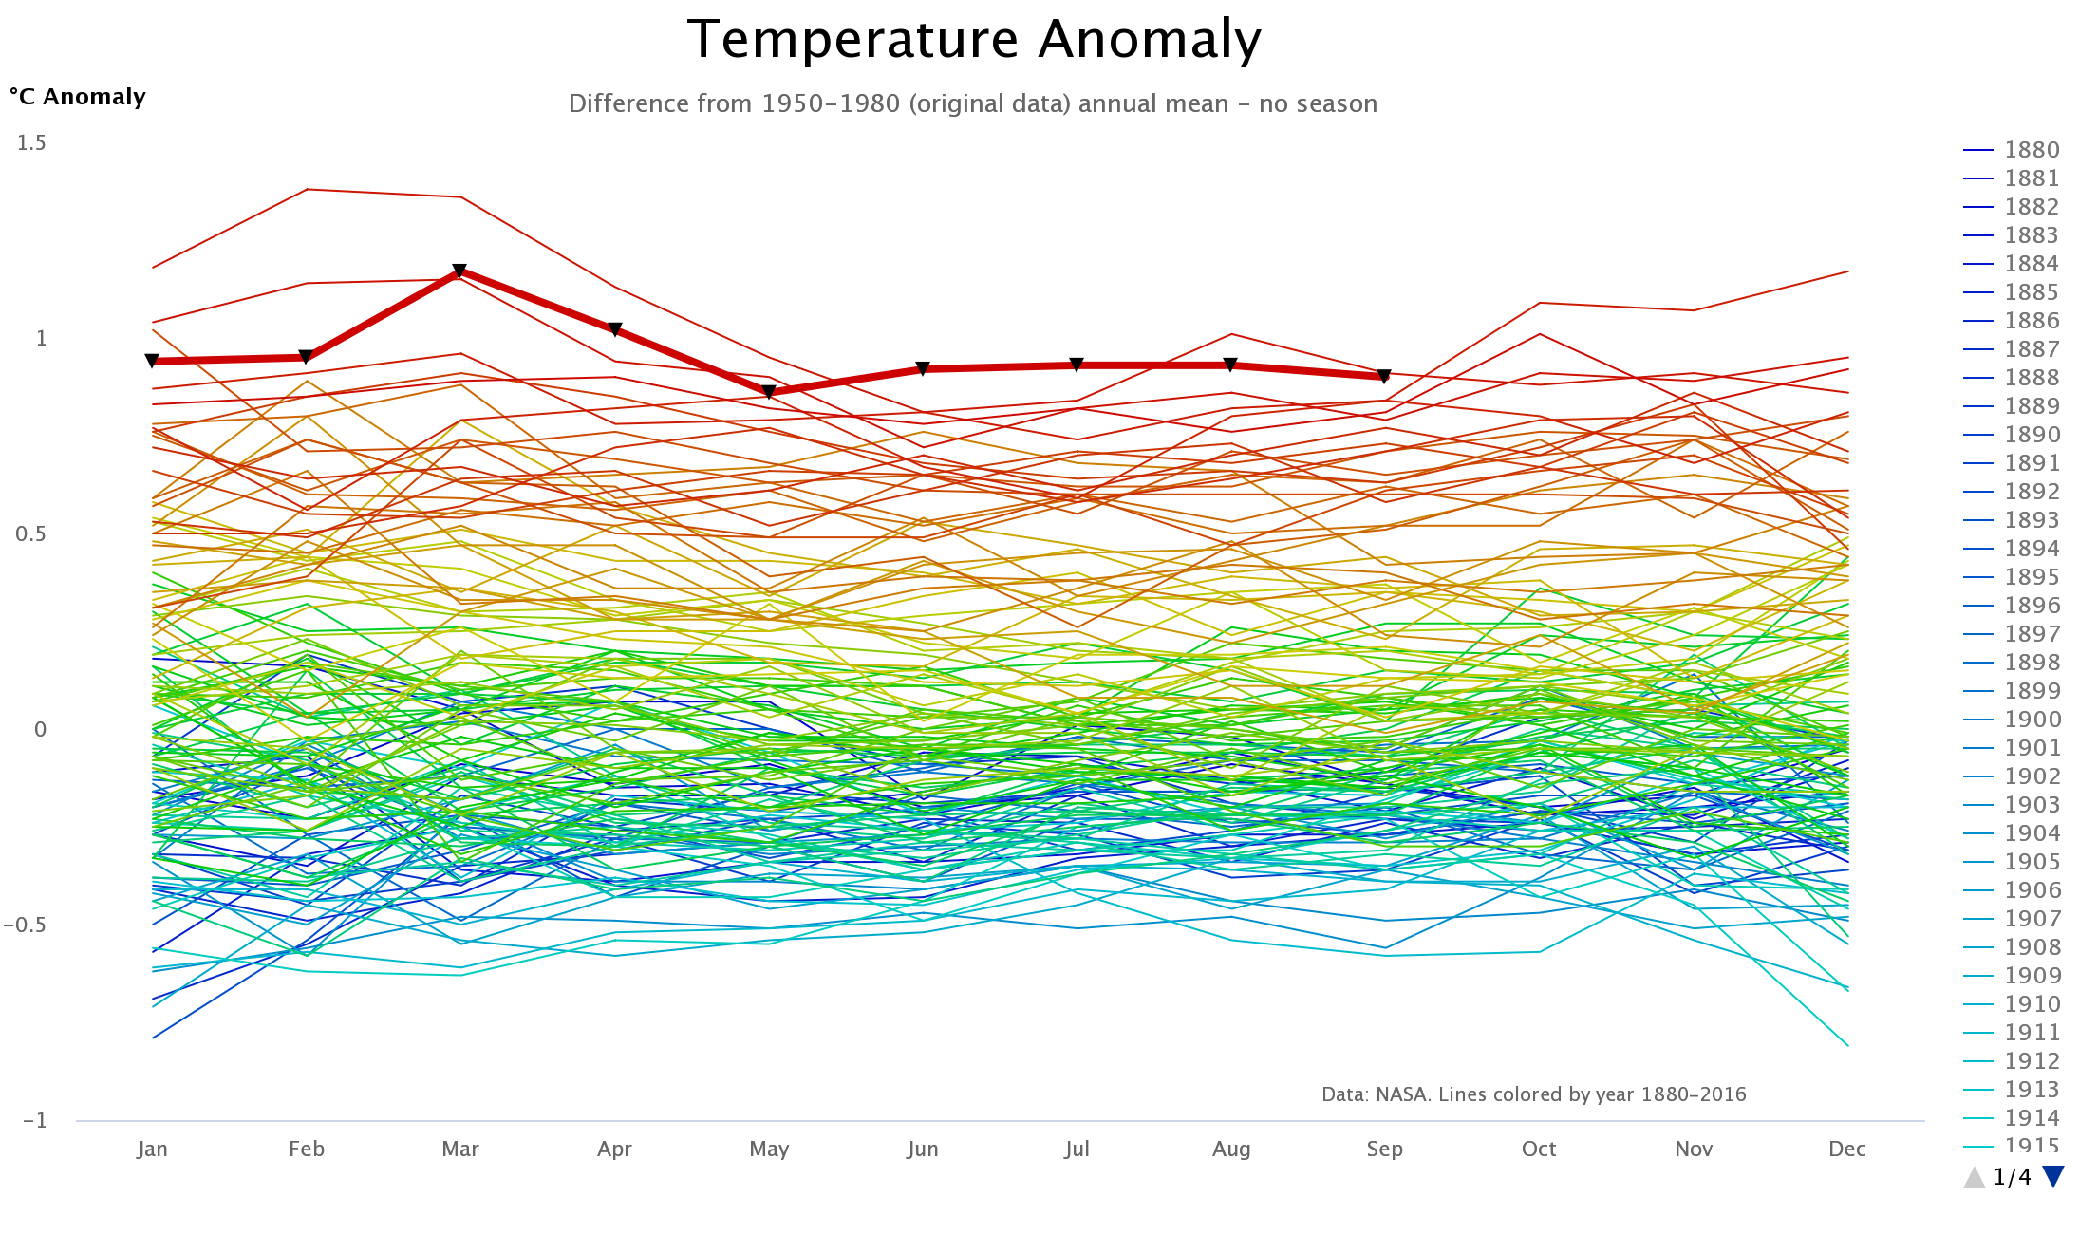
Climate Change
Notes:
Last May, the CO2 concentration reached Recent evidence suggests that the Earth, now passing 411 ppm CO2 in the atmosphere, has already transgressed the planetary boundary and is approaching several Earth system thresholds.

Slide 13
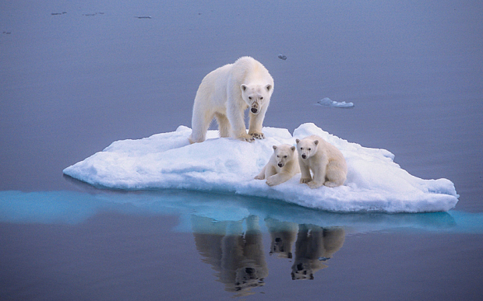
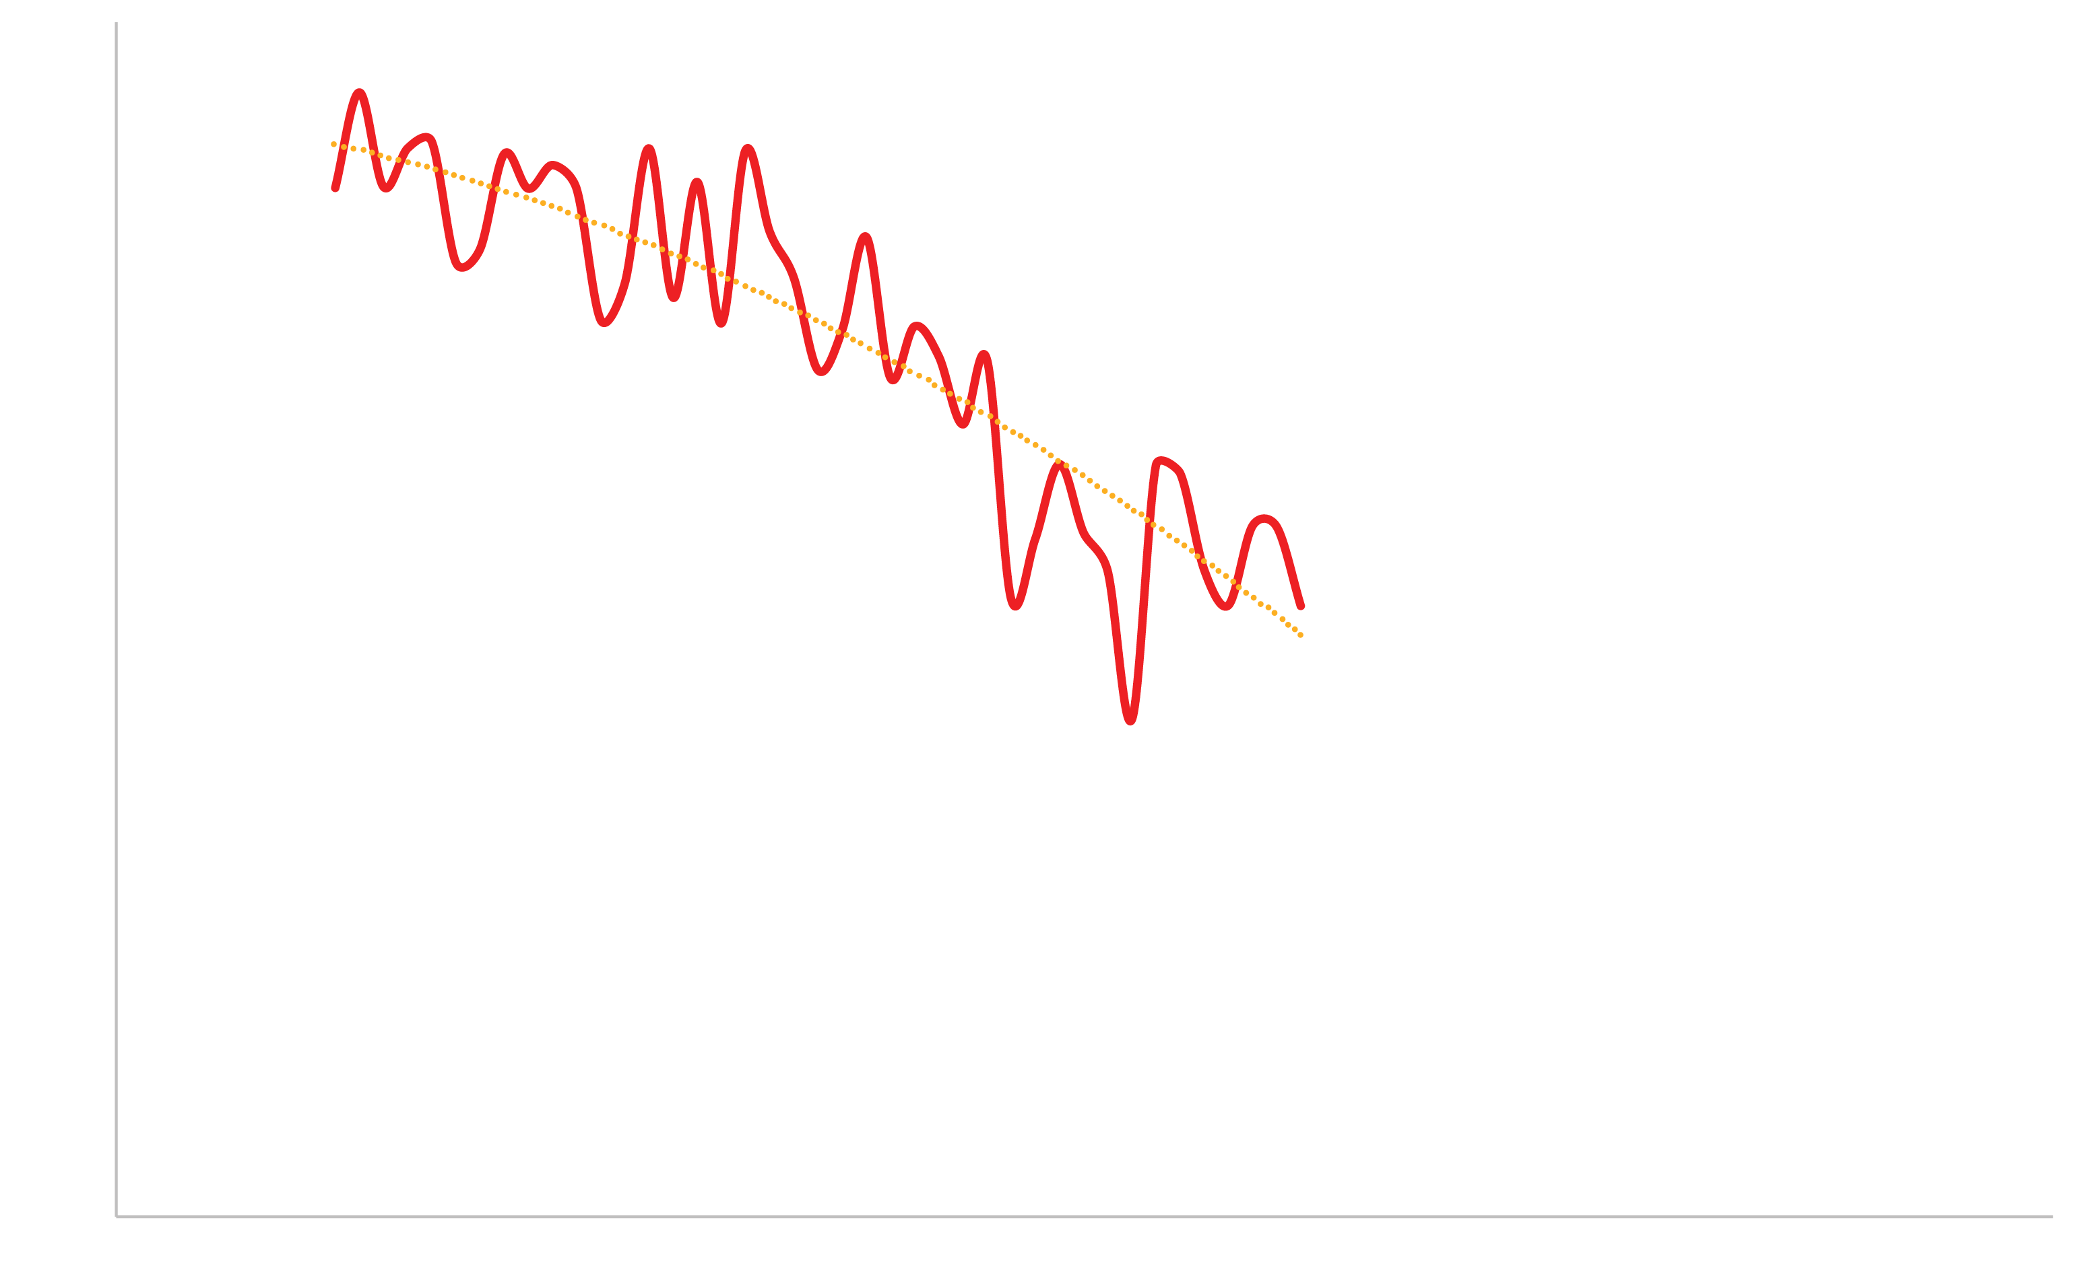
Climate Change
Notes:
We have reached a point at which the loss of summer polar sea-ice is almost certainly irreversible. The weakening or reversal of terrestrial carbon sinks, for example through the on-going destruction of the world's rainforests, is another potential tipping point, where climate-carbon cycle feedbacks accelerate Earth's warming and intensify the climate impacts. A major question is how long we can remain over this boundary before large, irreversible changes become unavoidable.

Slide 14
Ocean Acidification
Notes:
Around a quarter of the CO2 that humanity emits into the atmosphere is ultimately dissolved in the oceans. Here it forms carbonic acid, altering ocean chemistry and decreasing the pH of the surface water. Beyond a threshold concentration, this rising acidity makes it hard for organisms such as corals and some shellfish and plankton species to grow and survive. Losses of these species would change the structure and dynamics of ocean ecosystems and could potentially lead to drastic reductions in fish stocks. Compared to pre-industrial times, surface ocean acidity has already increased by 30 percent.

Slide 15
Freshwater
Notes:
According to UNEP GEO-6 report. 1.4 million people die from pathogen-plluted drinking water and 2.3 billion do not have access to safe sanitation. 40% of the wetalnds are gone. Freshwater species population declined 81% btw 1970 and 2012.
Freshwater cycle is strongly affected by climate change and its boundary is closely linked to the climate boundary, yet human pressure is now the dominant driving force determining the functioning and distribution of global freshwater systems. By 2050 about half a billion people are likely to be subject to water-stress, increasing the pressure to intervene in water systems.

Slide 16
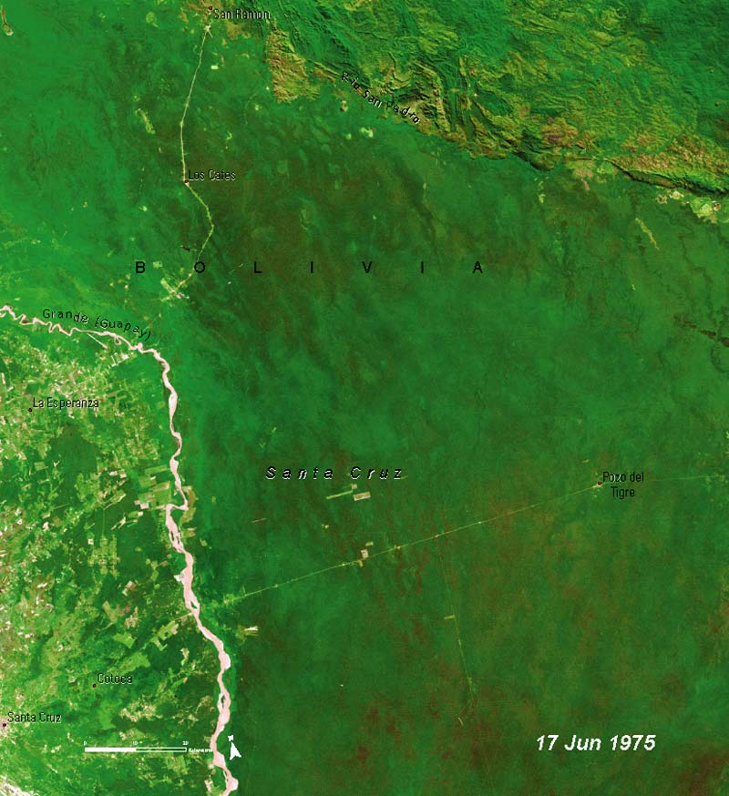
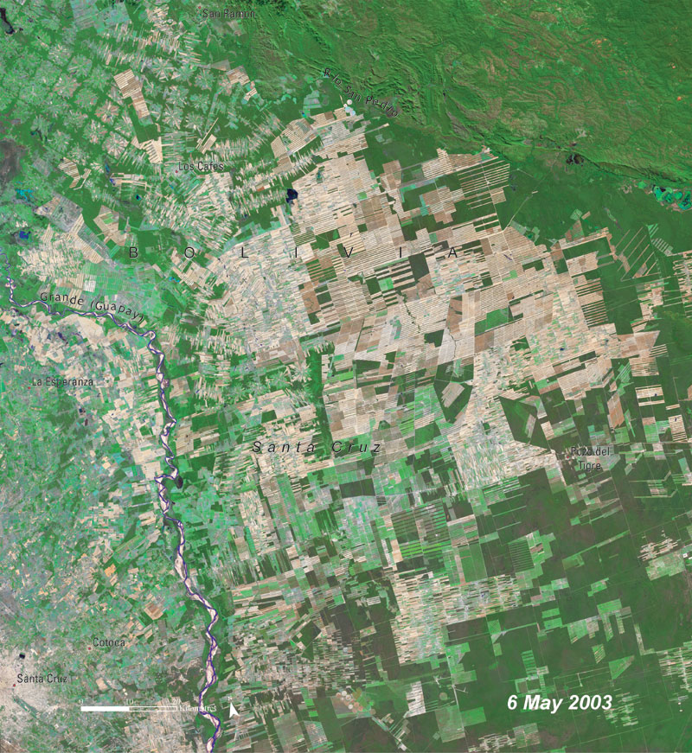
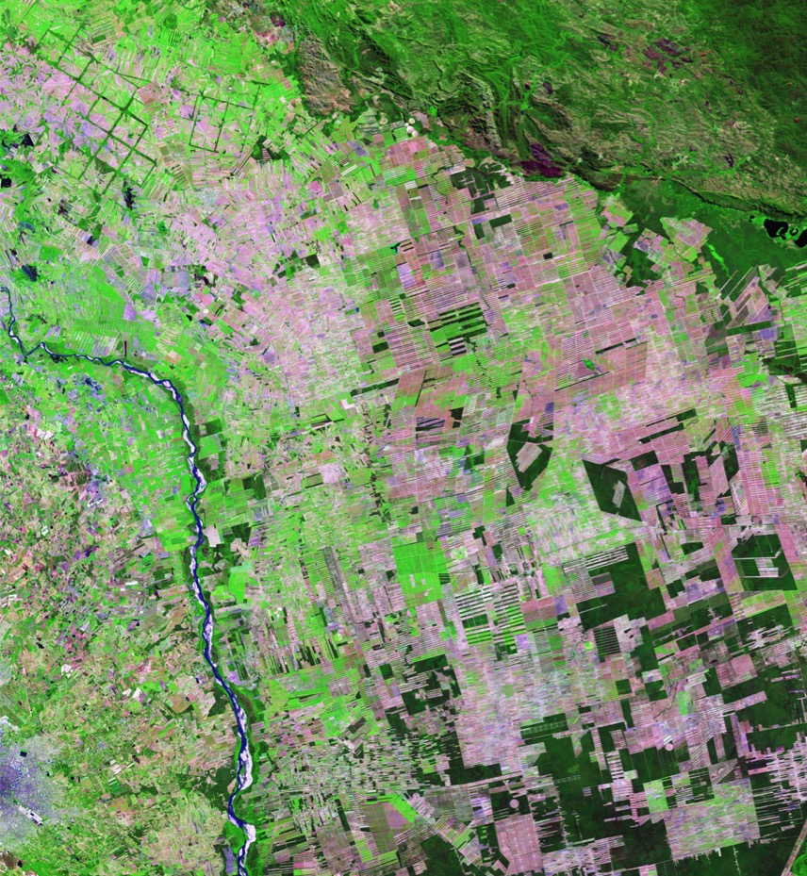
Land system change
20 July 2016
Notes:
Land is converted to human use all over the planet. Primarily for food production. We need 50% more food to feed the 10 billion people of the planet in 2050. African population will double by 2055. We are wasting 30% of food production.
This land-use change is one driving force behind the serious reductions in biodiversity, and it has impacts on water flows and on the biogeochemical cycling of carbon, nitrogen and phosphorus and other important elements. Forests play a particularly important role in controlling the linked dynamics of land use and climate, and is the focus of the boundary for land system change.

Slide 17
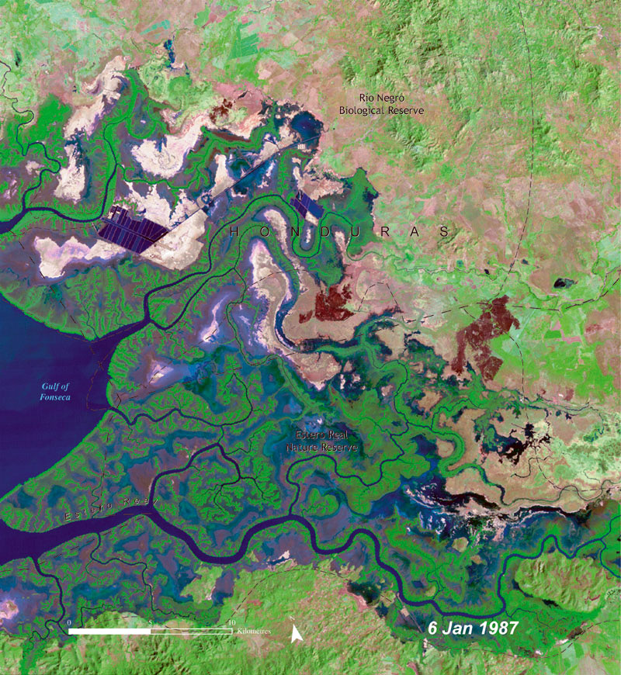
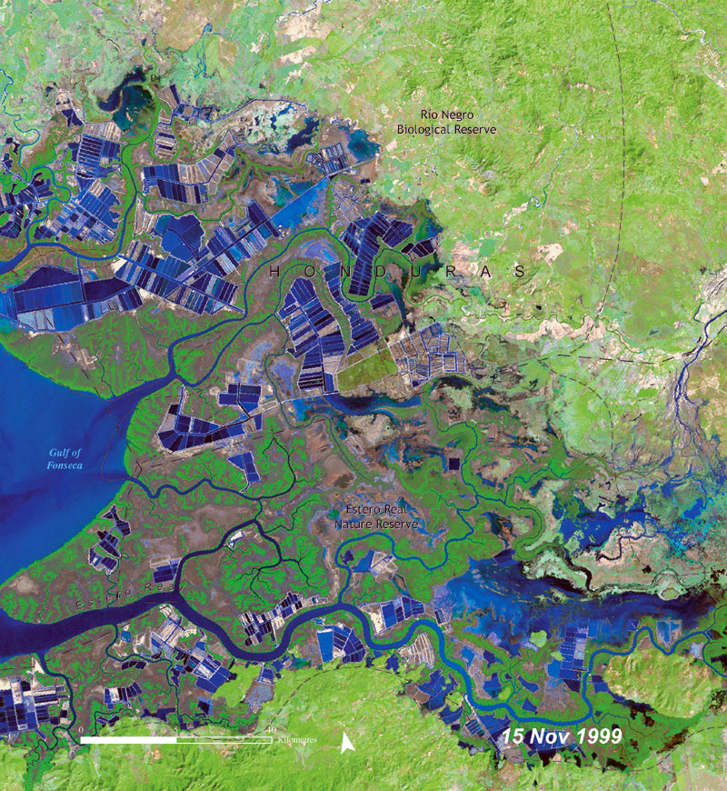
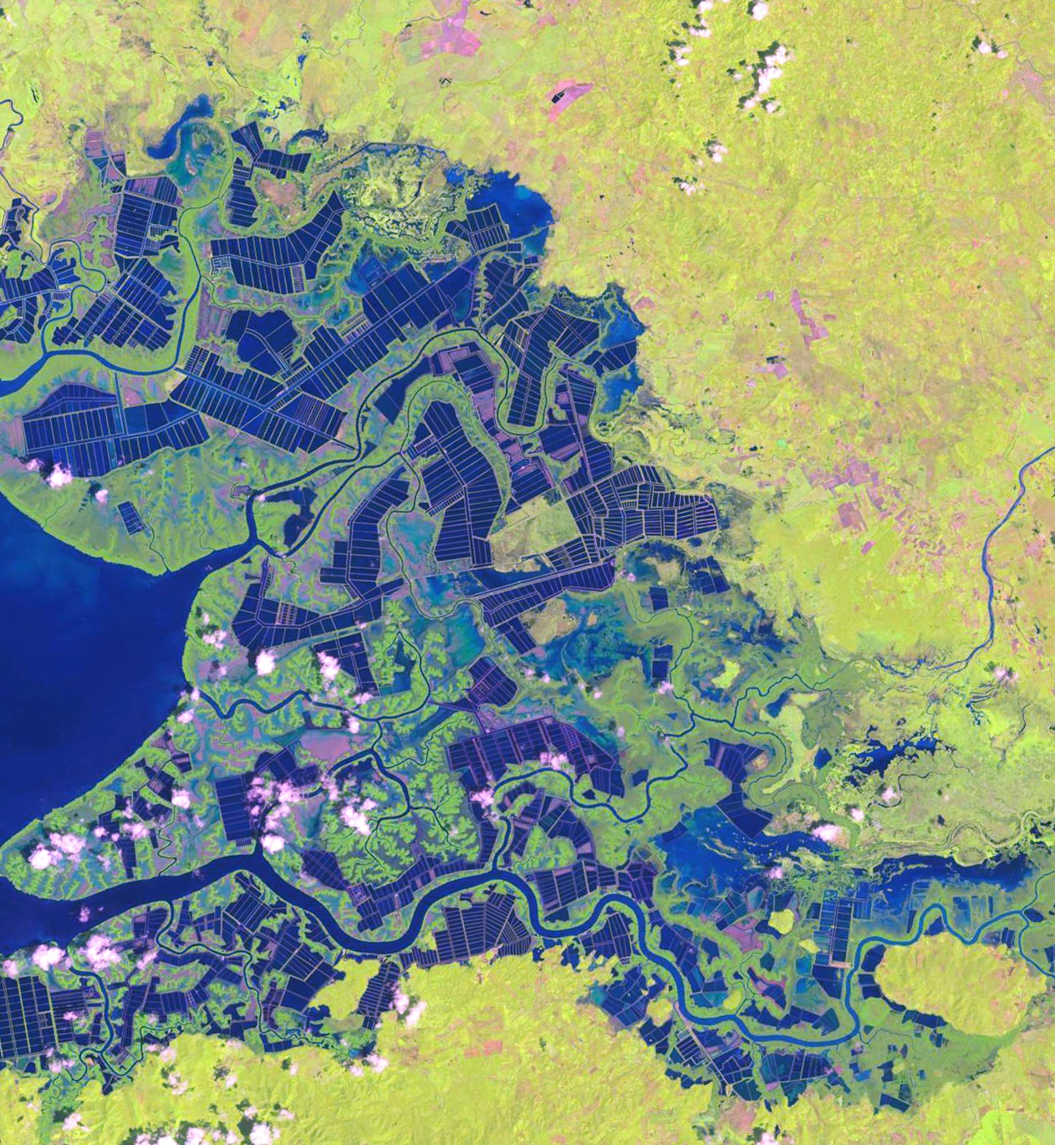
Land system change
12 Oct. 2013
Notes:
Land is converted to human use all over the planet. Primarily for food production. We need 50% more food to feed the 10 billion people of the planet in 2050. African population will double by 2055. We are wasting 30% of food production.
This land-use change is one driving force behind the serious reductions in biodiversity, and it has impacts on water flows and on the biogeochemical cycling of carbon, nitrogen and phosphorus and other important elements. Forests play a particularly important role in controlling the linked dynamics of land use and climate, and is the focus of the boundary for land system change.

Slide 18
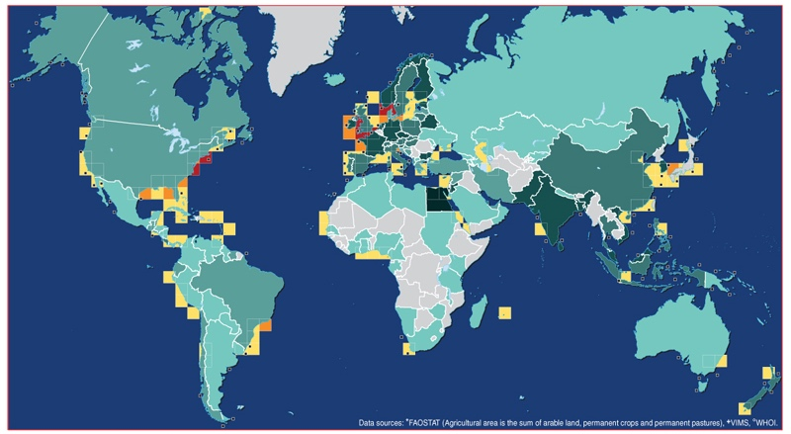
N & P
Notes:
Nitrogen and phosphorus are both essential elements for plant growth, so fertilizer production and application is the main concern. Human activities now convert more atmospheric nitrogen into reactive forms than all of the Earth's terrestrial processes combined. A relatively small proportion of phosphorus fertilizers applied to food production systems is taken up by plants; much of the phosphorus mobilized by humans also ends up in aquatic systems. These can become oxygen-starved as bacteria consume the blooms of algae that grow in response to the high nutrient supply. A significant fraction of the applied nitrogen and phosphorus makes its way to the sea, and can push marine and aquatic systems across ecological thresholds of their own.

Slide 19
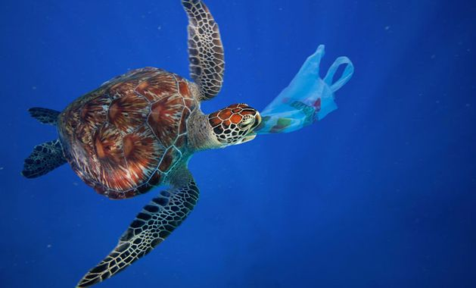
Plastic
Notes:
8 million t. of plastic enter the ocean each year.

Slide 21
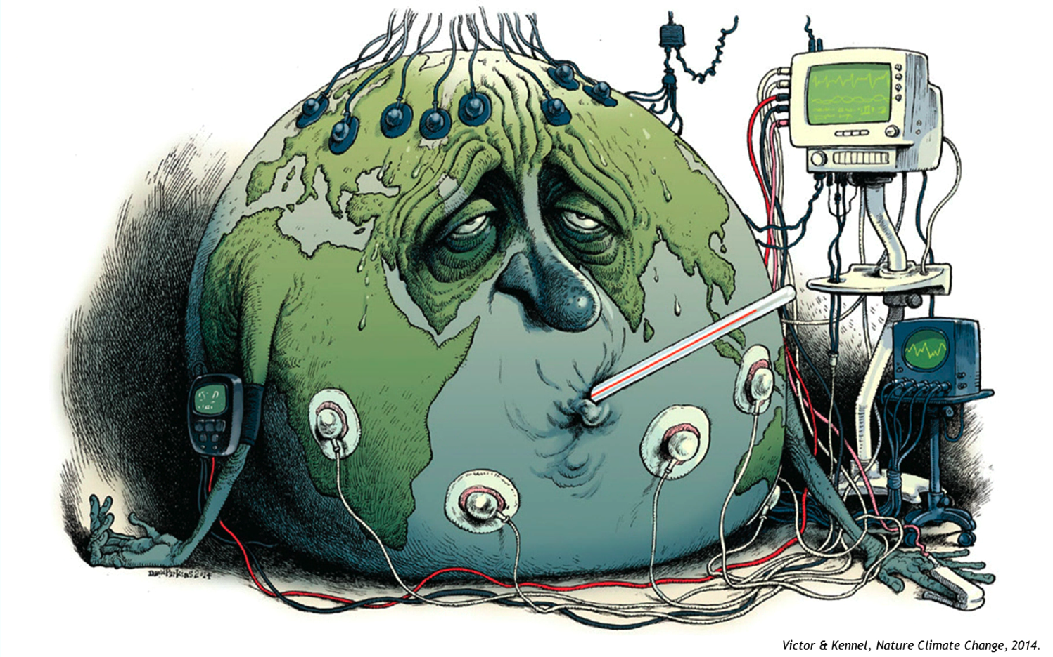
The Idea

Slide 22
We do not need (only) data for measuring progresses on SDGs
We need data to achieve the SDGs!

Slide 23
Can AI resolves the SDGs challenge ?
1.1 By 2030, eradicate extreme poverty for all people everywhere, currently measured as people living on less than $1.25 a day

Slide 24
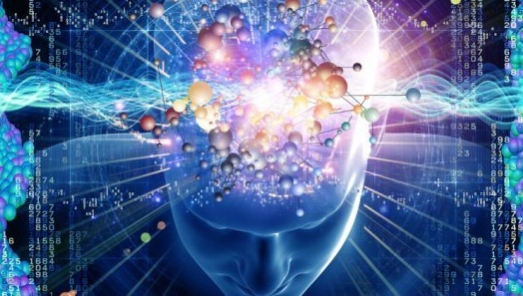
1.1 By 2030, eradicate extreme poverty for all people everywhere, currently measured as people living on less than $1.25 a day
Notes:
Can A.I. Big data, IoT, block chain solve our big challenge? Well A.I. is not a god or a magic thing. It can help to deal with big data.

Slide 25
Notes:
We shouldn’t take our decisions on something we do not understand.

Slide 26
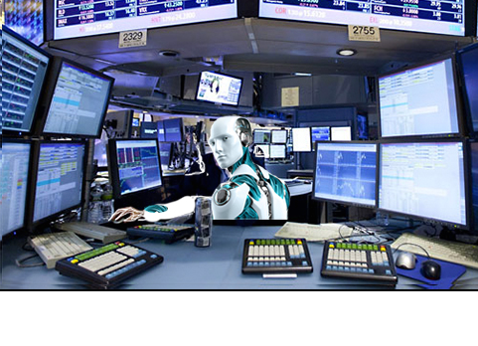
Notes:
https://iknowfirst.com/tag/ibm-watson-supercomputer

Slide 27
Data to achieve the SDGs
Use data, big or not, block chain, A.I. for reducing human footprints and increase efficiency of human system. Such as electricity consumption reduction, design of storage capacity, more efficient renewable energy sources.
Use artificial intelligence for designing circular economy … not for nano-second stock exchange trading.
Use big data for understanding the complexity of Drivers, Pressures, Status, Impacts and Response. Not for changing the course of democracies.

Slide 28
Data to achieve the SDGs
Use large computation modelling for running scenarios of future pathway. But not only for supporting climate change scenarios, but to find the pathway to sustainability.
Use satellite imagery, not only for monitoring deforestation, but also for avoiding deforestation and understand where to do reforestation.
Use data for enforcement of laws and resolution (such as fish ban).
Use block chain technology for good traceability, or Life Cycle analysis.
Use IoT for smart GRID using renewable energy when produced. Not for selling more stuff.

Slide 29
Principles guiding the strategic implementation
Simplification: Put in place a simple, easy to use knowledge system, providing transparent access, use and sharing of environmental data
Rationality: Avoid duplication of information and build on existing information and data sources as well as procedures, partnerships and intergovernmental processes already in place.
Low cost: to the extent possible, design a low-cost system to design and operate based on the use of existing open source software and related tools
Outward: Focus on responding to Member State requests and needs for evidence-based policy making and action.
Impact: Focus on key performance indicators, impactful, effective and efficient delivery on the ground and on people.
Partnership: build on existing and innovative partnerships including citizens and civil society, business as well as the UN system bodies and entities.

Slide 30
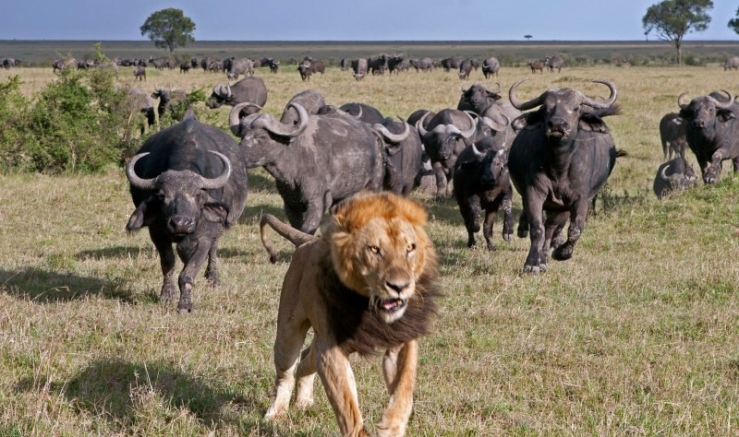
WE NEED PARTNERSHIP… to get stronger

