Slide 1


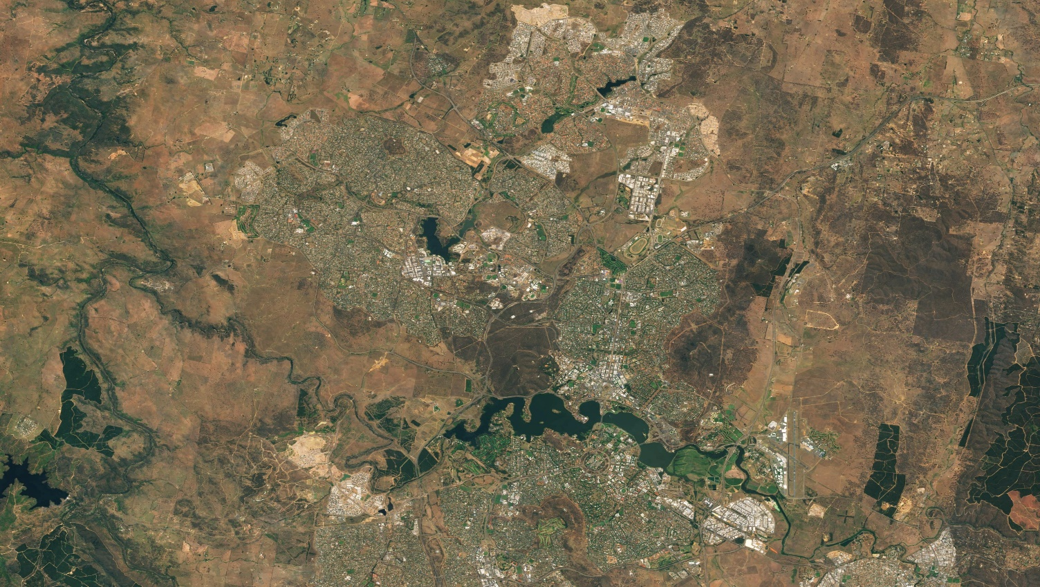
Towards an Open Data
Economy
and Ethical Infrastructure
Jean Dusart – Policy Officer
Directorate Healthy Planet – C3
Directorate General Research & Innovation
EUROPEAN COMMISSION
jean.dusart@ec.europa.eu
Canberra from Sentinel-2 cloudless - https://s2maps.eu by EOX IT Services GmbH (Contains modified Copernicus Sentinel data 2017 & 2018)
Working Group on Big Data and Digital Ecosystem For the Planet

Slide 2
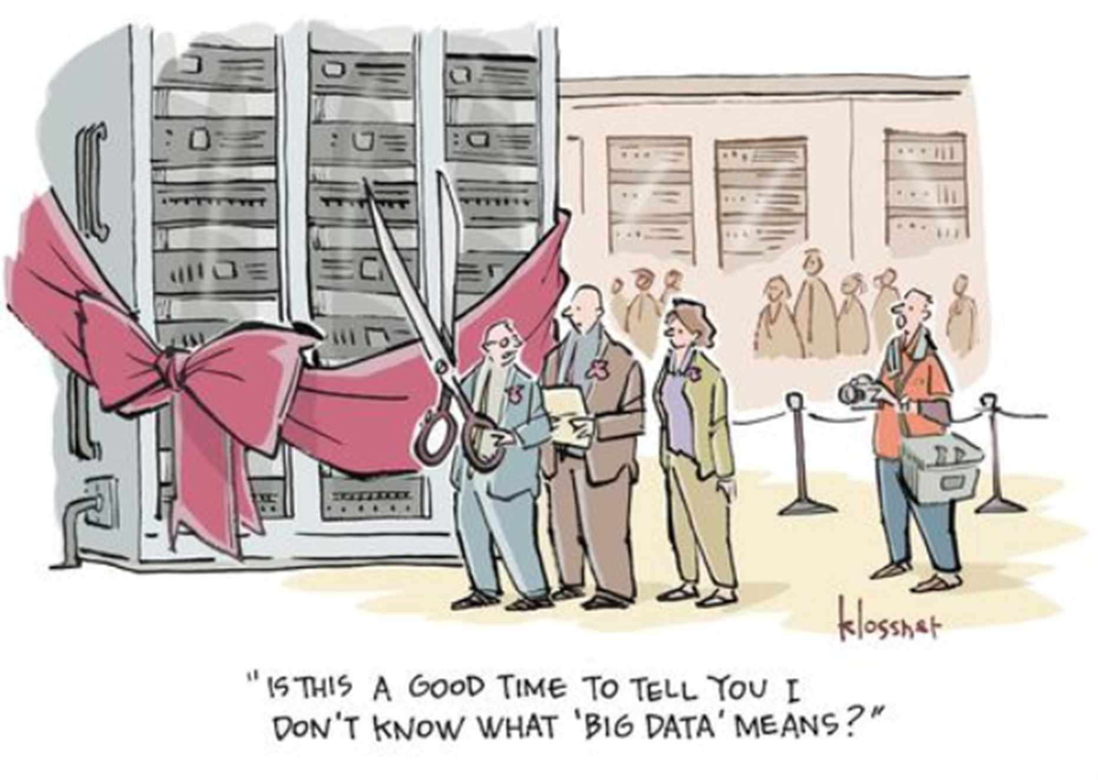

Outline of the presentation
Data Innovation
Dreams versus reality
Digital Initiatives of the European Union
Implications for the Digital Ecosystem for the Environment

Slide 3
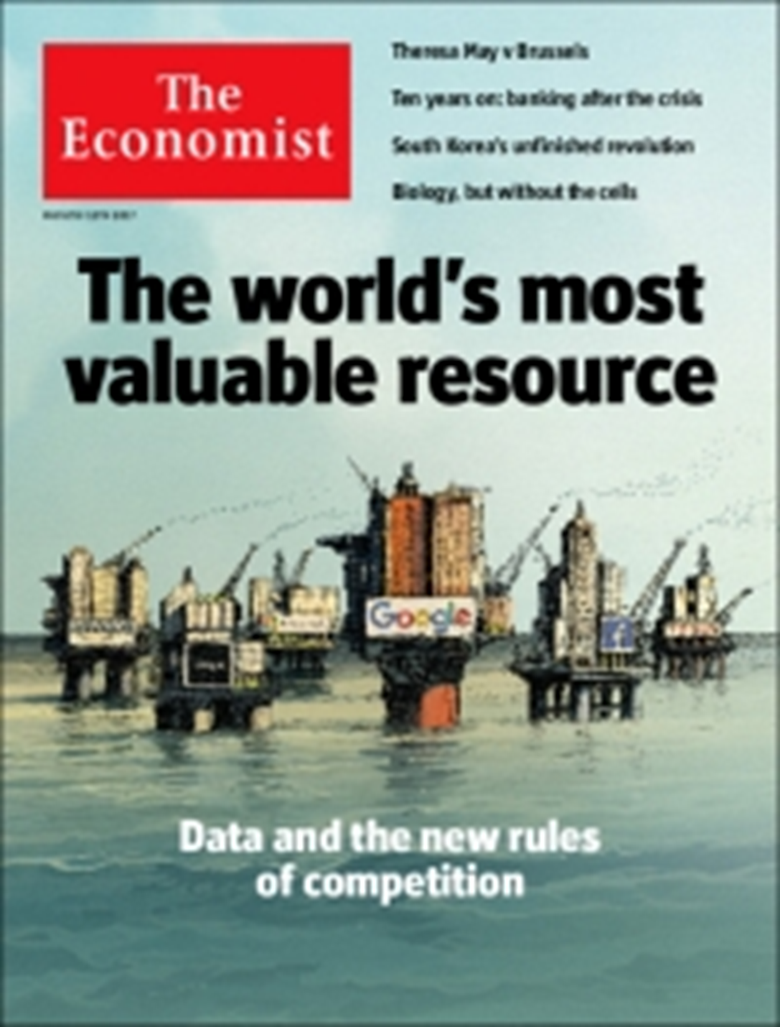
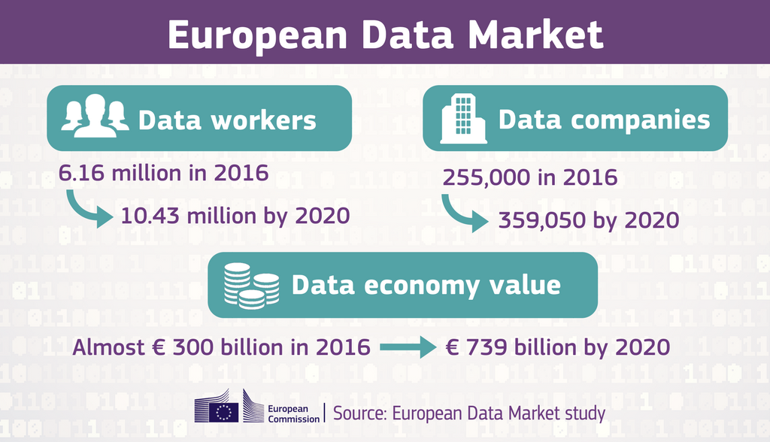
Data innovation is often seen as this…

Slide 4

But it might probably be better described as this…
Main issues we are facing:
Challenges regarding the availability, quality, organization, accessibility and sharing of geospatial information
Governance
Open/Closed policies (flow of data)
AI trustworthiness
Data re-use
Privacy

Slide 5


Digital Initiatives of the European Union (1/2)
Availability and re-usability of publicly-held or publicly funded data, including research data
Fair and open data markets (legal framework, technical mechanisms)
Business-to-Government Data Sharing for Public Interest purposes under preferential conditions for reuse
Open data policies
European Open Science Cloud

Slide 6

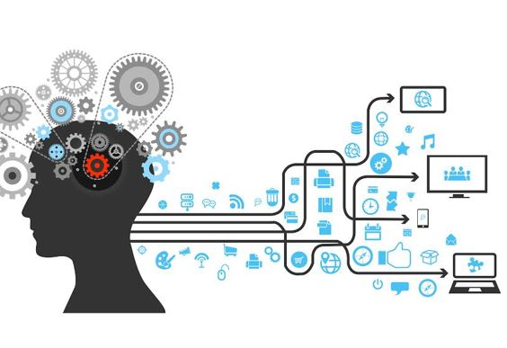
Digital Initiatives of the European Union (2/2)
Codes of conduct facilitating the switch between cloud service providers
Appropriate ethical and legal framework on Artificial Intelligence (COM(2019)168: Building Trust in Human-Centric Artificial Intelligence):
    Human agency and oversight
    Technical robustness and safety
    Privacy and data governance
    Transparency
    Diversity, non-discrimination and fairness
    Societal and environmental well-being
    Accountability

Slide 7
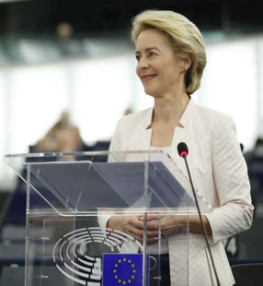
A European Green Deal
A Europe fit for the digital age
« Digital technologies, especially Artificial Intelligence (AI), are transforming the world at an unprecedented speed. They have changed how we communicate, live and work. They have changed our societies and our
economies. » (U. von der Leyen)
« In order to release that potential we have to find our European way, balancing the flow and wide use of data while preserving high privacy, security, safety and ethical standards. . »
Notes:
Global warming has reached 1°C above preindustrial level and is increasing at approximately 0,2°C per decade
18 of the warmest years in the last 2 decades and extreme heat waves in EU for 4 of the last 5 years
IPCC and IPBES reports warn about global ecosystems in danger already at 2°C with serious impacts on EU economy & environment
Reaching the Paris Agreement goals is still possible but requires an unprecedented transition (scale and speed)
The new Commission is setting the agenda for becoming the world’s first climate neutral continent by 2050 with proposing a European Green Deal

Slide 8


Integrated Geospatial Information Framework
A Strategic guide to develop and strengthen national geospatial information management.
The UN Statistics Division and World Bank launched a framework for countries seeking guidance in the management of geospatial information.
The framework recommends seven principles and provides specific suggestions for pursuing nine strategic pathways in order to implement integrated geospatial information systems.
Underpinning principles: Strategic Enablement; Transparent and Accountable; Reliable, Accessible and Easily Used; Collaboration and Cooperation; Integrative Solution; Sustainable and Valued; Leadership and Commitment
UN-GGIM

Slide 9
Implications for the Digital Ecosystem for the Environment
Need for the setting-up of a modern data governance based on commonly agreed rules of participation
Users 'oriented developments (versus technology driven)
Inclusive of the GEOSS Data sharing principles (recognized and used for designing the Copernicus Full and Open Access Policy) so that the information is effectively accessible and re-usable.
Taking into account the downstream part of the value chain
Development according to ethical and governance principles (take example of the AI guidelines)
Ethics and inclusivity in governance and system designs should remain a key priority

Slide 10

Thank You!
Jean Dusart,
European Commission
Directorate-General Research & Innovation
Email: jean.dusart@ec.europa.eu

